Slide 1
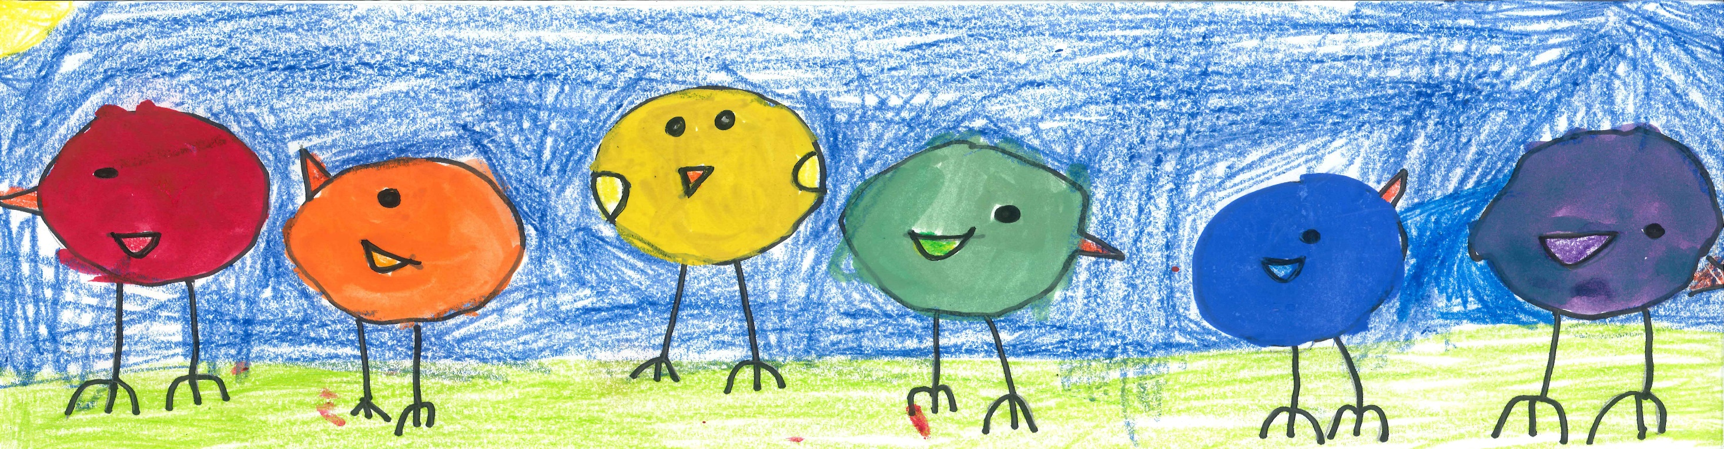
Engaging and Retaining Young Men Who Have Sex with Men (YMSM) in Culturally Responsive Services
INSERT TRAINER
Notes:
Welcome participants to training.
Introduce title and trainer(s) for this training.
Identify YMSM+ LGBT CoE as the organization who developed curriculum.
If the entire, full-day training is delivered, the total hours of the curriculum is 6 hours. The suggested start and end times for the training are 8:30am to approximately 4:30pm. That includes 2 breaks and an hour-long lunch break. There is a sample agenda included.
The duration of the entire training depends on the level of participant questions, comments and discussion. Also, the duration of the training is impacted by slight modifications made to respond to group’s prior knowledge. Additional content can be added to localize and/or augment information. However, the expectation is that these slides will be presented as is, to ensure uniformity across the country.
A half-day training can be scheduled in a 4 hour timeframe.
Art Work by Emma R (first grader).

Slide 2




The ATTC Network
National Focus Centers
Regional Centers
National American Indian and Alaska Native ATTC
Central Rockies ATTC (8)
ATTC Network Coordinating Office
New England ATTC (1)
Northwest
Frontier
ATTC (10)
YMSM+LGBT CoE
Northeast
ATTC (2)
PPW CoE
Great Lakes
ATTC (5)
National
SBIRT ATTC
Mid-America
ATTC (7)
Central East
ATTC (3)
National
Frontier and Rural ATTC
Pacific
Southwest
ATTC (9)
Southeast ATTC (4)
South by Southwest ATTC (6)
Cmnwlth Northern
Mariana Islands
Hawaii
Puerto Rico,
US Virgin Islands
Guam
Republic of the
Marshall Islands
Palau
Federated States
of Micronesia
National Hispanic and Latino ATTC
www.attcnetwork.org
American
Samoa
Notes:
The domestic ATTC Network is a nationwide, multidisciplinary resource for professionals in the addictions treatment and recovery services field. Established in 1993 by the Substance Abuse and Mental Health Services Administration (SAMHSA), the domestic ATTC Network is currently comprised of 10 Regional Centers, 4 National Focus Area Centers, and a Network Coordinating Office. Together the Network serves the 50 U.S. states, the District of Columbia, Puerto Rico, the U.S. Virgin Islands, and the Pacific Islands of Guam, American Samoa, Palau, the Marshal Islands, Micronesia, and the Mariana Islands.
The mission of the ATTC Network is to (1) accelerate the adoption and implementation of evidence-based and promising addiction treatment and recovery-oriented practices and services; (2) heighten the awareness, knowledge, and skills of the workforce that addresses the needs of people with substance use or other behavioral health disorders; and; (3) foster regional and national alliances among culturally diverse practitioners, researchers, policy makers, funders, and the recovery community. The vision of the ATTC Network is to unify science, education and service to transform lives through evidence-based and promising treatment and recovery practices in a recovery-oriented system of care.
2

Slide 3
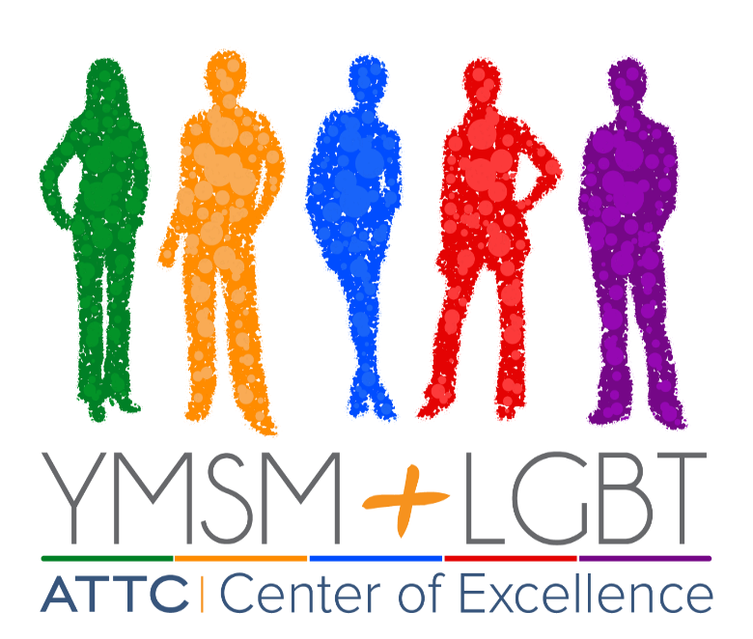
The Center of Excellence on Racial and Ethnic Minority Young Men who have Sex with Men (YMSM) and other Lesbian, Gay, Bisexual, and Transgender (LGBT) Populations
YMSM + LGBT CoE
Provides training and technical assistance on culturally responsive prevention and treatment services with a goal to…
Decrease rates of substance use and HIV infections among racial/ethnic minority YMSM (18-29), and other LGBT individuals
Three year program ended in 2017.
Website still available.
www.ymsmlgbt.org
Notes:
The Center of Excellence on Racial and Ethnic Minority Young Men Who Have Sex with Men and Other Lesbian, Gay, Bisexual, and Transgender Populations (YMSM+LGBT CoE) was established to help providers develop skills to deliver culturally-responsive and evidence based prevention and treatment services for lesbian, gay, bisexual, and transgender populations dealing with co-occurring substance use and mental health disorders. Additionally, the CoE will provide a variety of innovative training and technical assistance resources, including training curricula, webinars, and a website clearinghouse to help providers working with LGBT populations and racial/ethnic minority young men who have sex with men (ages 18-29).
The Center of Excellence is funded by SAMHSA as a supplement to the Pacific Southwest Addiction Technology Transfer Center, in partnership with the National American Indian and Alaska Native ATTC and the Northeast and Caribbean ATTC.

Slide 4
YMSM+LGBT CoE
Pacific Southwest ATTC
UCLA ISAP
Tom Freese,
Brandy Oeser, Beth Rutkowski
National American Indian and Alaska Native ATTC
University of Iowa
Anne Helene Skinstad,
Matt Ignacio, Lena Thompson
Northeast and Caribbean ATTC
NDRI
Mike Chaple and Paul Warren
National Hispanic and Latino ATTC
Universidad Central del Caribe, Bayamon, Puerto Rico
Charles R. Drew University
An Historically Black Graduate Institution and Hispanic-Serving Health
Professional Schools
The ATTC Network
Participation at the discretion of each center
Notes:
The Center of Excellence is funded by SAMHSA as a supplement to the Pacific Southwest Addiction Technology Transfer Center, in partnership with the National American Indian and Alaska Native ATTC and the Northeast and Caribbean ATTC. Additional partners include the National Hispanic and Latino ATTC based at the Universidad Central del Caribe, in Bayamon, Puerto Rico, and Charles R. Drew University, an historically black graduate institution and Hispanic-serving health professional school located in Los Angeles, California.

Slide 5
LGBT Curriculum
A Provider’s Introduction to Substance Abuse Treatment for Lesbian, Gay, Bisexual, and Transgender Individuals (Second Edition)
  Focus on areas of LGBT health as it is related to substance abuse treatment, approaches, families, and other health related concerns
  Visit www.ymsmlgbt.org for more information!
Notes:
The curriculum is designed to develop provider skills in delivering culturally responsive prevention and treatment services for LGBT populations. Content focus areas include: physical health, substance abuse treatment, mental health, and other health related concerns for LGBT populations. The curriculum also provides treatment strategies and considerations for clinical work that have been effective with LGBT populations.

Slide 6
Today’s Agenda
8:30 - 9:45 Welcome, Introductions & Module 1 - Key Terms
9:45 - 10:15 Module 2 – Related Health Issues
10:15 - 10:30 Morning Break
10:30 - 11:15 Module 2 – Continued
11:15 - 12:00 Module 3 – Working Effectively with Culturally Diverse Clients
12:00 – 1:30 Lunch Break (on your own)
1:30 – 2:30 Module 4 –Minority Stress
2:30 – 3:00 Module 5 – Treatment Considerations
3:00 – 3:15 Afternoon Break
3:15 – 4:00 Module 5 – Promising Practices
4:00 – 4:30 Questions & Evaluations
Notes:
This slide features a sample daylong training agenda with a start time of 8:30 and an end time of 4:30. Adjustments can be made, as needed, if you plan to present for less than one full day, or plan to rearrange the order of the modules.

Slide 7

Group Agreements
Be respectful when others are speaking
Speak from your own experience (use “I” statements)
Take risks (be open to learning and asking questions)
Respect confidentiality
Have fun
Notes:
The trainer(s) and training participants are dedicating valuable time to create a successful learning opportunity. It is important to establish some group agreements to create a positive, productive and safe learning environment.
The material in this training can be sensitive, personal and emotional. It is important that participants feel respected and safe during the training, and free to ask any questions they may have. A way we can “set the stage” is by collectively establishing group agreements.
This is a short list of common group agreements used in trainings. Trainer(s) might prepare the flip chart paper or dry erase board with the above list before the training so that all the participants are able to see and read them.
Then, while trainer(s) are discussing this slide, ask participants to suggest other ideas to create a safe, fun, productive learning environment. You may also add to and refer back to the list as the training moves forward throughout the day.

Slide 8

Housekeeping
Complete necessary paperwork (sign in and out, evaluations)
Manage your electronics – silence phones, calls outside
Location of bathrooms
Options for lunch
Notes:
Here is a sample list of housekeeping or overall training logistics participants may need to be aware of.
By discussing these items at the beginning of the training, participants will be less likely to interrupt the training in the event they need to answer a phone call, use the restroom and handle business outside of the training.
It is highly recommended you prepare a list of lunch options that are close-by the training facility so participants have time to purchase and consume lunch in a timely manner.
Suggestions of lunch options need to include a wide range of costs and cuisine.

Slide 9
Introduction & Key Terms
MODULE 1
Notes:
The purpose of this module is to provide participants with terms and concepts that are mentioned throughout the entire training.
Many people often have questions about these definitions. These definitions are meant to provide a basic understanding of who the target populations are.
Trainer(s) and participants may find challenges to use one definition to define entire populations.
Trainer(s) needs to be mindful these definitions may not reflect different regions, cultures and communities. These are working definitions for this training.
Participants may have their own definitions and it is important to validate those definitions and experiences.

Slide 10
Goal of Module
To define YMSM and other key related terms
To identify strategies for exploring client’s identity
To examine population characteristics
Notes:
Trainer reviews the goals of the module by informing participants that at the end of Module I they will be able to:
a) Define YMSM and other key related terms
To identify strategies for exploring client’s identity
To examine population characteristics

Slide 11

John is a 29-year-old man living in California. He’s been married to his wife for 4 years, and secretly having sex with men for 13 years.
He uses Craigslist and dating sites like Squirt.org to meet guys and prefers to hook up with other married men.
“Hooking up with other men, to me, is a non-complicated way of releasing sexual steam. It’s simply a physical release with no pressure,” he said. “I seek out other married men for the simple fact that they are in the same boat as me, and hopefully can relate to what I am looking for,” he says. “I do not want to jeopardize my marriage. Another married man can understand that. I do find some men attractive, but for me, it’s just sexual. I don’t feel attracted to men in a loving way at all.”
11
Notes:
The Centers for Disease Control (CDC) recently reported that an unprecedented number of Americans identify as bisexual. The CDC study also found that more men who identify as straight admit to having same-sex sex. Sometimes, attraction to same-sex love affairs becomes a routine part of their lives.
After interviewing more than 9,000 people age 18 to 44, the CDC discovered 6.2 percent of the male participants admitted that they had same-sex sex at least once in their lives, and 2.3 percent of those men identified as straight. In a nutshell, more straight men are having sex with men, and many of them continue to engage in same-sex activities throughout their lives.
“We can learn a lot about sexual fluidity and diversity from men on the down low. Some men on the DL identify as bisexual but are not public about their sex with men. Others are completely straight-identified and view their sex with men as an erotic hobby, so to speak. For them, it’s an occasional means of getting off, but it’s not something that feels significant enough to influence how they understand their sexual orientation.”

Slide 12


YMSM Defined
  MSM: Men who have Sex with Men
  Male persons who engage in sexual activity with members of the same sex, regardless of how they identify themselves; these men may or may not identify as gay, homosexual or bisexual
        Term used in CDC surveillance systems.
        Indicates a behavior, not how people self-identify in terms of their sexuality.
  YMSM: MSM between the ages of 18-29 years
Notes:
Read the text on the slide and proceed to the next slide.
The CoE request for proposals (RFP) defined the target population of YMSM as those 18-29 years of age.

Slide 13
Exploring Identity
A way to avoid bias and judgment towards male clients who engage in sex with other males is to avoid labeling a client’s sexual orientation based on their behavior only.
  – Example: “He must be gay if he sleeps with men.”
For some men, their same-sex sexual encounters may be restricted by institutional settings.
  – Example: military, prisons, sleep away camp, boarding schools, college, seminary, fraternities or other predominantly gender-specific environments.
We aim to respect and affirm clients’ identities, regardless of our opinions and judgments.
Whatever word, description and or term client’s use, we should reflect that wording in our interactions with that client.
Notes:
Again, providers respect and honor the client’s chosen identify. If a client identifies as “straight,” we honor that description and use the same terminology when interacting and describing the client. If the client identifies as “gay,” we honor and use the term. If the client declines to identify or label themselves, we honor that decision as well.
Same-gender sexual behaviors can occur only in certain environments. For some clients, these behaviors may have happened in the past, and may never occur again. For other clients, it may be important to discuss prevention strategies if the client is planning on returning to a specific environment (example: prison) where he has historically engaged in same-gender sexual behaviors .

Slide 14

The Kinsey Scale
0 Exclusively heterosexual
1 Predominantly heterosexual, incidentally homosexual
2 Predominantly heterosexual but more than
incidentally homosexual
3 Equal heterosexual and homosexual
4 Predominantly homosexual, but more than
incidentally heterosexual
5 Predominantly homosexual , incidentally
heterosexual
6 Exclusively homosexual
0-----------1---------------2------------------3-----------------4------------------5---------------6
63%
37%
10%
(Kinsey et al., 1948)
Notes:
Alfred Kinsey was one of the first researchers to include bisexual behavior as a component of sexual orientation. His scale measured sexual orientation on a seven-point scale (Kinsey et al., 1948; Kinsey et al., 1953).
The purpose of this slide is to provide a general description of the Kinsey Scale.
As pictured, there is a continuum of behaviors ranging from exclusively heterosexual to exclusively homosexual. Rather than divide the world into discrete categories (i.e. homosexual and heterosexual), Kinsey sought to offer a wider range and spectrum to human sexuality.
The original scoring via interviews and evaluation for the Kinsey Scale was not meant to categorize or label individuals as heterosexual, bisexual, or homosexual.
Rather, the Kinsey scale was to highlight the complexity of human sexuality. [Advance Animation] Kinsey’s data showed that 63% of men reported a score of “0.” [Advance Animation] That means that 37% had at least some same-sex sexual behavior. [Advance Animation] 10% reported a score of “6” indicated that they were exclusively. These data were collected via interview (in the mid 1940’s ) and are therefore probably an underrepresentation. More recent anonymous surveys using the Kinsey scale indicate that as many as 67% of participants scored 1-6, with 10% still scoring “6.” (http://g0ys.org/skewedchart.htm)

Slide 15
The interrelatedness of terms
It is important for providers to understand the four core concepts of identity related to gender and sexual orientation:
Sex Assigned at Birth
Gender Identity
Gender Expression
Sexual Orientation
Notes:
It is important to highlight everyone (including non-trans clients) has a gender identity, gender expression, sex assigned at birth and a sexual orientation.
The trainer(s) can use themselves or a hypothetical client as an example. “Brian” was born with male sexual reproductive organs at birth, and was assigned “male” at birth. Since he was an adolescent, “Brian” has identified as “male” and expresses his gender as a “male” (e.g. plays sports, wears ‘male’ clothing, plays with other ‘males’) and since adolescence, “Brian” identifies as “heterosexual.” Therefore he has all four core concepts of identity, expression, sex assignment and sexual orientation.
Sex assigned at birth: A combination of biological markers (chromosomes and hormones) and anatomic characteristics (reproductive organs and genitalia). Impacted by legal, policy, cultural and social issues.
Gender expression: how one externally manifests their gender identity through behavior, mannerisms, speech patterns, dress, and hairstyles.
Gender identity: A person’s internal sense of their own gender. (Keatley, Deutsch, Sevelius & Gutierrez-Mock, 2015)
Sexual orientation: distinct from gender identity and expression. Describes a combination of attraction, behavior and identity for sexual and/or romantic partners. (Keatley, Deutsch, Sevelius & Gutierrez-Mock, 2015)

Slide 16
The interrelatedness of terms
Sex Assigned at Birth
X
F I M
Gender Identity
X
F A M
Gender Expression
X
F A M
Sexual Orientation
X
F B M
Notes:
Make it clear that these terms are also fluid- could change over time. Especially with youth.
Before the training, trainer should move the Xs on the above chart so that they describe their own definitions on each of the 4 terms. The trainer can use themselves as an example and a hypothetical example. It is a good idea to possibly use young person as an example.
To understand the interrelationship of these terms, it is best to think of each of them as a continuum with female on one end and male on the other.
For Sex Assigned at Birth for instance, the child will generally be assigned “female” or “male” depending upon external sex characteristics observed at birth. Some children may be identified as intersex due to difference in development.
For Gender Identity, we ask a client where they fall on the continuum between male and female in terms of their internal identity. Clients may fall on one end or may identify as genderqueer or somewhere in the middle.
Gender Expression or Gender Role relates to how one externally manifests their gender identity through behavior, mannerisms, speech patterns, dress, and hairstyles.
And Sexual Orientation describes a combination of attraction, behavior and identity for sexual and/or romantic partners. It is based on the gender identity of the individual and the gender identity of those that they are romantically affectionately, and/or sexually attracted to. Someone may be exclusively attracted to males, females, or both, along the continuum.
After defining each of the continua, advancing the slides will animate in each X, one at a time. Advancing one final time, will cause the Xs to disappear and then the Trainer can describe their identity and then give a couple of examples of other identities (e.g., a person with a different gender identity, a person with a different sexual orientation).

Slide 17
The interrelatedness of terms
Sex Assigned at Birth
X
F I M
Gender Identity
X
F A M
Gender Expression
X
F A M
Behavior
Sexual Orientation
X
F B M
Notes:
Make it clear that these terms are also fluid- could change over time. Especially with youth.
Before the training, trainer should move the Xs on the above chart so that they describe their own definitions on each of the 4 terms. The trainer can use themselves as an example and a hypothetical example. It is a good idea to possibly use young person as an example.
To understand the interrelationship of these terms, it is best to think of each of them as a continuum with female on one end and male on the other.
For Sex Assigned at Birth for instance, the child will generally be assigned “female” or “male” depending upon external sex characteristics observed at birth. Some children may be identified as intersex due to difference in development.
For Gender Identity, we ask a client where they fall on the continuum between male and female in terms of their internal identity. Clients may fall on one end or may identify as genderqueer or somewhere in the middle.
Gender Expression or Gender Role relates to how one externally manifests their gender identity through behavior, mannerisms, speech patterns, dress, and hairstyles.
And Sexual Orientation describes a combination of attraction, behavior and identity for sexual and/or romantic partners. It is based on the gender identity of the individual and the gender identity of those that they are romantically affectionately, and/or sexually attracted to. Someone may be exclusively attracted to males, females, or both, along the continuum.
After defining each of the continua, advancing the slides will animate in each X, one at a time. Advancing one final time, will cause the Xs to disappear and then the Trainer can describe their identity and then give a couple of examples of other identities (e.g., a person with a different gender identity, a person with a different sexual orientation).

Slide 18
The interrelatedness of terms
Sex Assigned at Birth
F I M
Queer
Non Conforming
Not defined
Gender Identity
F A M
Gender Expression
F A M
Sexual Orientation
F B M
Notes:
The problem with these continua is that they are still based on binary understanding of gender and sexual orientation. Some people do not use these concepts to define themselves. The may define themselves as “Queer,” “Non conforming,” or “not defined.” Therefore a client may describe their sexual orientation as “queer” or “not defined.” They may describe their gender as “gender queer” or “gender nonconforming” or may use a variety of other terms to state the they see themselves as outside of the Male Female binaries. These continua and definitions are provided to help the provider understand the vast diversity of presentations. Providers should use the terms used by the clients.

Slide 19


A Note About
Adolescent Development
19

Slide 20
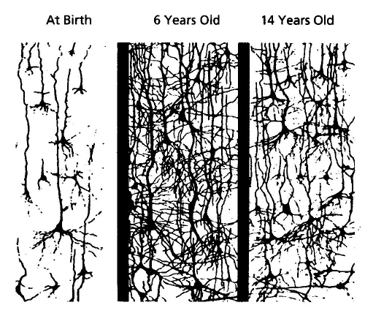
Continuing Brain Development
Early in development, synapses are rapidly created and then pruned back. Children’s brains have twice as many synapses as the brains of adults. Shore, 1997
Notes:
**ANIMATION**
This drawing illustrates the pruning process.
Move forward to reveal first picture
Between birth and 6 years of age…
Move forward to reveal second picture
…there is a tremendous proliferation of neural connections.
Move forward to reveal final picture
This is followed by sustained thinning starting around puberty. Scientists think this process reflects greater organization of the brain as it prunes redundant connections, and increases in myelin, which enhance transmission of brain messages.
REFERENCE
Shore, R. (1997). Rethinking the Brain. New York: Families and Work Institute.

Slide 21

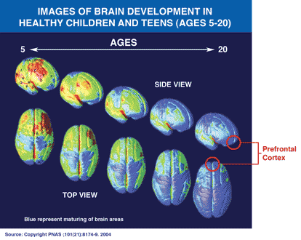
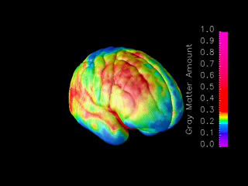
Brain Development
Ages 5-20 years
MRI scans of healthy children and teens compressing
15 years of brain development (ages 5–20).
Red indicates more gray matter, blue less gray matter.
Neural connections are pruned back-to-front.
The prefrontal cortex ("executive" functions), is last to mature.
Information taken from NIDA’s Science of Addiction
http://www.drugabuse.gov/ScienceofAddiction/
Source: Paul Thompson, Ph.D.
UCLA Laboratory of Neuroimaging
Notes:
Constructed from MRI scans of healthy children and teens, the time-lapse "movie", from which the above images were extracted, compresses 15 years of brain development (ages 5–20) into just a few seconds. Red indicates more gray matter, blue less gray matter. Gray matter wanes in a back-to-front wave as the brain matures and neural connections are pruned. Areas performing more basic functions mature earlier; areas for higher order functions mature later. The prefrontal cortex, which handles reasoning and other "executive" functions, emerged late in evolution and is among the last to mature. Studies in twins are showing that development of such late-maturing areas is less influenced by heredity than areas that mature earlier.
Source: Paul Thompson, Ph.D.
UCLA Laboratory of Neuroimaging
21

Slide 22
The interaction between the developing nervous system and drugs of abuse leads to:
Difficulty in decision making
Difficulty understanding the consequences
of behavior
Increased vulnerability to memory and attention problems
This can lead to:
Increased experimentation
Increased risk associated with substance use, coping, mental health, etc.
Feillin, 2008
Notes:
In reality, the exact impact of substance use on the developing brain is not known. However, when we look at the impact on the adult brain and understand normal development, several things seems true about this interaction, including that it may lead to difficulties in decision making and understanding the consequences of behavior (Fiellin, 2008). Additionally, it may increase the risk of memory and attention problems. These impairments, in turn, may lead to increased experimentation across a variety of behaviors; and increase the risk of addiction to a variety of substances (Fiellin, 2008).

Slide 23
So, What Do We Know about YMSM?
23
Notes:
This next section explores – what do we know about YMSM?

Slide 24
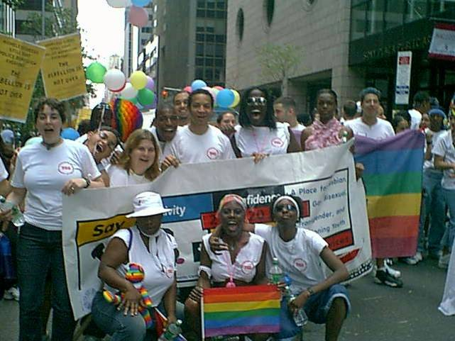
Limitations in our knowledge of the LGBT (and YMSM) Populations
Lack of reliable data on the number of lesbians, gay men, bisexuals, and transgender people in the general population
  Reluctance to disclose sexual orientation, gender identity, and drug use
  Use of convenience samples which may bias results (e.g., collecting data in gay bars, from LGBT events, or at HIV service organizations)
YMSM is often inclusive of gay and bisexual young men so that it may be difficult to distinguish YMSM who do not identify as gay/bi-sexual
Notes:
Research considerations:
It is important to remember the challenges of data collection on a population that doesn’t have a universally understood agreement on the term “YMSM.”
The lack of inclusion of trans men and the historical inclusion of trans women in YMSM-related research poses additional challenges.

Slide 25
More Research Needed
Sexual minorities who do not identify as gay or bisexual are generally under studied
MSM is not an identity so it is inherently difficult to engage for further study
Research about Gay and Bisexual men (sexual minorities) may be extrapolated to YMSM
Notes:
Trainer should underscore the following points:
1. Emerging research connects minority stress with sexual minority populations to describe the risk for negative outcomes on mental and physical health.
2. Few such studies have explored mental & physical health among men who actively deny a sexual minority sexual identity label (such as gay or bisexual) while engaging in same-sex sexual behaviors.
3. Although some forms of minority stress can be experienced by any socially stigmatized minority group, hiding one’s sexual minority status or identity and internalized homophobia are unique to sexual minority individuals. This is may be another factor of minority stress than may be extrapolated to YMSMs. Even without choosing to claim a gay or bisexual identity, YMSMs may experience similar stress related to the stigma and internalized homophobia.
Sources:
Effects of Minority Stress Processes on the Mental Health of
Latino Men Who Have Sex with Men and Women: A Qualitative Study.
Holloway, IW, Padilla, MB, Willner L, Guilamo-Ramos V.
Archives of Sexual Behavior, Nov 2014
Minority stress and physical health among sexual minority individuals.
David M. Frost, Karen Lehavot, Ilan H. Meyer,
Journal of Behavioral Medicine, June 2013

Slide 26
Limitations in our knowledge of the LGBT (and YMSM) Populations
Studies often conducted only with cisgender men and/or do not specifically identify if transgender men are included in the sample:
  Results cannot be generalized to transgender men.
  The specific needs of transgender YMSM cannot be identified and addressed.
  Source: Xu, 2010
Notes:
The lack of inclusion of trans men and the historical inclusion of trans women in YMSM-related research poses additional challenges.
Source:
Xu, F., Sternberg, M.R., & Markowitz, L.E. (2010). Men who have sex with men in the United States: demographic and behavioral characteristics and prevalance of HIV and HSV-2 infection: results from national health and nutrition examination survey 2001-2006. Sexually Transmitted Diseases, 37(6): 399-405.

Slide 27
LGBT, MSM and YMSM
There is not a lot of information specific to YMSM – so in many instances we cover what we know from the larger LGBT populations.
Throughout this curriculum we present information on the available information relevant to the topic from LGBT communities in general, older MSM and, YMSM where available.
We will then extrapolate from that information to YMSM
population and highlight implications.
The lack of data is a limitation in the field. Feel free to ask or comment if it is confusing or you draw different conclusions.
Notes:
Since there is not a lot of information specific to YMSM in many instances we cover what we know from the larger LGBT populations in this curriculum. We present information on the available information relevant to the topic from LGBT communities in general, older MSM and, YMSM where available. We then extrapolate from that information to YMSM population and highlight implications.
The lack of data is a limitation in the field.

Slide 28

Study: Latino MSM in New York City
Avoided disclosure about their sexual lives for fear of:
Social isolation
Depression
Suicidality
Self-injury
SOURCE: Holloway et al., 2014.
Notes:
Few studies have explored mental health among men who actively deny a sexual minority sexual identity label (gay, bisexual) while engaging in same-sex sexual behaviors. The 2014 New York City study used ethnographic interview data from 20 non-gay-identified MSM Dominican and Puerto Rican men. The men described being “outed” about their same sex sexual behavior as a threat to their intimate relationships, community affiliation, and counter to expectations of Latino masculinity. Men reported fearing social isolation, depression, suicidality, and self-injury (self-inflicted harm and bodily safety risks) as possible outcomes from disclosing sexual behavior with other men to their female romantic partners. Though this looked at MSM – we might be able to extrapolate similar thoughts amongst YMSM.
Effects of Minority Stress Processes on the Mental Health of
Latino Men Who Have Sex with Men and Women: A Qualitative Study.
Holloway, IW, Padilla, MB, Willner L, Guilamo-Ramos V.
Archives of Sexual Behavior, Nov 2014

Slide 29

So what do we know?
Studies vary widely, citing that between 1% and 10% of the population is LGBT. Commonly cited recent study indicates that 3.8% of the population is LGBT (Williams Inst Review, 2011)
As part of National Health and Nutrition Examination Surveys in 2001-2006, men 18-59 years of age were interviewed about sexual behavior. Of the 4,319 men interviewed, 5.2% (225 men) reported having ever had sex with men (MSM) (Xu, Sternberg, Markowitz, 2010).
  Only 44.5% (100) of these MSM identified as gay or bisexual.
Numbers of LGBT/MSM are inconsistent due to varying definitions of behavior, identity, attraction, fantasy, etc.
Notes:
In the Xu study, 55.5% of the men with histories of same-sex behavavior.
Xu, F., Sternberg, M.R., & Markowitz, L.E. (2010). Men who have sex with men in the United States: demographic and behavioral characteristics and prevalance of HIV and HSV-2 infection: results from national health and nutrition examination survey 2001-2006. Sexually Transmitted Diseases, 37(6): 399-405.

Slide 30
Providers Considerations:
For some men (including young men) there is concern for stigma, ridicule, violence and even homicide if they are suspected to be anything other than heterosexual.
Just because a male client has previously engaged or currently engages in sexual activity with other men does not suggest he is gay or bisexual. Many “straight” identified men have had sex with other men.
We meet clients anywhere along the continuum of sexual behaviors, orientations and identities – our goal is to be effective helpers.
Notes:
One way providers can build trust and create a safe environment for clients is to provide services from a nonjudgmental stance.
Another way to build trust is to refrain from gossiping or discussing client’s sexuality with co-workers who are not on a need-to-know basis.

Slide 31

Related Health issues for YMSM
MODULE 2
Notes:
This next section will cover related health issues specific to YMSM. It is important for providers to view the client as a whole being, aiming to increase wellness not just in some areas, but in all areas of the client’s life. When we do this – the client is likely to achieve better health outcomes.
Research shows that homophobia, transphobia, and heterosexism all contribute negatively to LGBT/YMSM youth's mental, spiritual, emotional, and physical well-being, as evidence by high rates of attempted and completed suicide, violence victimization, substance abuse, teenage pregnancy, and HIV/STI-associated risky behaviors.

Slide 32
Goal of the Module
Review the prevalence and related risk factors of HIV/AIDS, co-occurring substance use and mental health issues, homelessness, suicide, and trauma/violence among YMSM
Examine the impact of race/ethnicity on the various risk factors
Notes:
This module will characterize the substance use patterns in YMSM, including sociodemographic characteristics and history associated with such use.

Slide 33

Why is it so important to focus on the HIV risk behaviors/factors of young men who have sex with men?
33
Notes:
As a way to introduce a group discussion that will follow in a couple of slides, pose this question to the audience, and engage in a brief discussion (3-5 minutes) as to why it is important to focus on the HIV risk factors of YMSM, especially racial/ethnic minority YMSM.

Slide 34
CDC Report - 2016
If current HIV diagnoses rates persist in the U.S.:
  1 in 2 Black MSM will be diagnosed with HIV during their lifetime
  1 in 4 Latino MSM will be diagnosed with HIV during their lifetime
  1 in 11 White MSM will be diagnosed with HIV during their lifetime
SOURCE: CDC, 2016
Notes:
If current HIV diagnoses rates persist, about 1 in 2 black men who have sex with men (MSM) and 1 in 4 Latino MSM in the United States will be diagnosed with HIV during their lifetime, according to a new analysis by researchers at the Centers for Disease Control and Prevention (CDC). The study, presented at the Conference on Retroviruses and Opportunistic Infections in Boston, provides the first-ever comprehensive national estimates of the lifetime risk of an HIV diagnosis for several key populations at risk and in every state. Gay and bisexual men continue to be most affected by the HIV epidemic in the U.S. At current rates, 1 in 6 MSM will be diagnosed with HIV in their lifetime, including 1 in 2 black MSM, 1 in 4 Latino MSM, and 1 in 11 white MSM. African Americans are by far the most affected racial or ethnic group with a lifetime HIV risk of 1 in 20 for men (compared to 1 in 132 for whites) and 1 in 48 for women (compared to 1 in 880 for whites). People who inject drugs are at much higher lifetime risk than the general population, and women who inject drugs have a higher risk than men (1 in 23 compared with 1 in 36). People living in the South are more likely to be diagnosed with HIV over the course of their lifetime than other Americans, with the highest risk in Washington, DC (1 in 13), Maryland (1 in 49), Georgia (1 in 51), Florida (1 in 54), and Louisiana (1 in 56).
http://www.cdc.gov/nchhstp/newsroom/2016/croi-press-release-risk.html

Slide 35
HIV Incidence among YMSM
In 2014, YMSM accounted for 80% of new HIV infections among 13-24 year olds in the U.S.
Between 2005 and 2015, HIV diagnoses among African American and Hispanic/Latino YMSM increased 87%
55% of HIV-positive YMSM in 2014 were African American
SOURCES: CDC, 2016; CDC, 2013; Prejean et al., 2011.
Notes:
Gay and bisexual men are more severely affected by HIV than any other group in the United States. Among all gay and bisexual men, African American gay and bisexual men bear a disproportionate burden of HIV. An estimated 9,731 youth aged 13 to 24 were diagnosed with HIV in 2014 in the United States. Eighty-one percent (7,868) of diagnoses among youth occurred in persons aged 20 to 24. Among youth aged 13 to 24 diagnosed with HIV in 2014, 80% (7,828) were gay and bisexual males. Of those newly diagnosed young gay and bisexual males, 55% (4,321) were black, 23% (1,786) were Hispanic/Latino, and 16% (1,291) were white. From 2005 to 2014, HIV diagnoses among both black and Hispanic/Latino gay and bisexual men aged 13 to 24 increased about 87%. Among young white gay and bisexual men, HIV diagnoses increased 56%. However, the most recent 5 years of data (2010-2014) indicate that the diagnoses among black and white gay and bisexual men aged 13 to 24 have stabilized and the increase has slowed to 16% among Hispanic/Latinos. In 2014, an estimated 1,716 youth aged 13 to 24 were diagnosed with AIDS, representing 8% of total AIDS diagnoses that year.
REFERENCES:
Centers for Disease Control & Prevention. (2016). HIV among youth, www.cdc.gov/hiv/group/age/youth/index.html (Accessed December 9, 2016).
Centers for Disease Control & Prevention. (2013). Diagnoses of HIV infection in the United States and Dependent areas, 2011. HIV Surveillance Report, 23.
Prejean, J., Song, R., Hernandez, A., et al. (2011). Estimated HIV incidence in the United States, 2006-2009. PLoS One, 6, e17502.

Slide 36
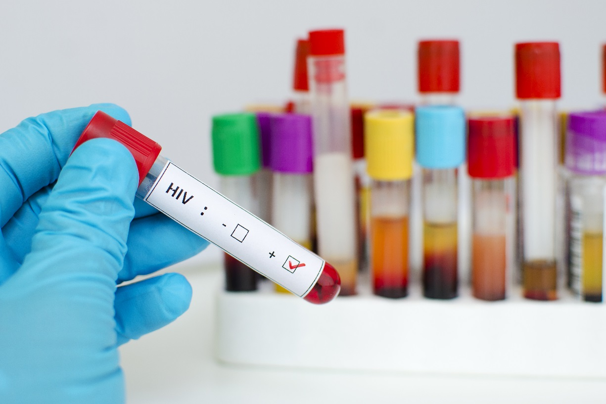
Risk Factors for HIV Infection among MSM
Four or more male sex partners
Unprotected receptive anal intercourse with any HIV serostatus partners
Unprotected insertive anal intercourse with HIV-positive partners
Amphetamine use
Heavy alcohol use
Alcohol or drug use before sex
Depressive symptoms
Gonorrhea
SOURCE: Koblin et al., 2006.
Notes:
According to Koblin and colleagues (2006), men reporting four or more male sex partners, unprotected receptive anal intercourse with any HIV serostatus partners and unprotected insertive anal intercourse with HIV-positive partners were at increased risk of HIV infection, as were those reporting amphetamine or heavy alcohol use and alcohol or drug use before sex. Some depression symptoms and occurrence of gonorrhea also were independently associated with HIV infection. The attributable fractions of high number of male partners, use of alcohol or drugs before sex, and unprotected receptive anal intercourse with unknown status partners and the same with presumed negative partners accounted for 32.3, 29.0, 28.4 and 21.6% of infections, respectively.
REFERENCE:
Koblin, B.A., Husnik, M.J., Colfax, G., Huang, Y., Madison, M., Mayer, K., Barresi, P.J., Coates, T.J., Chesney, M.A., & Buchbinder, S. (2006). Risk factors for HIV infection among men who have sex with men. AIDS, 20, 731-739.

Slide 37
STIs among MSM
Estimated incidence of gonorrhea among MSM increased from 1,170 cases per 100,000 MSM in 2010 to 1,474 cases per 100,000 MSM in 2013
Median site-specific gonorrhea prevalence among those tested in 2015 was 19% (range by site: 10.9%-22.7%)
Median site-specific chlamydia prevalence in 2015 was 16% (range: 11.8%-17.6%).
Among MSM presenting with primary and secondary syphilis in 2015, the proportion of those also infected with HIV ranged from 20.9% in Los Angeles to 58.6% in Baltimore.
Notes:
Gay, bisexual, and other men who have sex with men (collectively referred to as MSM) are at increased risk for STIs, including antimicrobial resistant gonorrhea, when compared to women and exclusively heterosexual men. Also, because STIs and the behaviors associated with acquiring them increase the likelihood of acquiring and transmitting HIV infection, STI incidence among MSM may also be an indicator of higher risk for subsequent HIV infection. With the exception of reported syphilis cases, most nationally notifiable STD surveillance data do not include information on sexual behaviors; therefore, trends in STDs among MSM in the United States are based on findings from sentinel and enhanced surveillance systems.
Data from the STD Surveillance Network (SSuN), a sentinel and enhanced surveillance project established in 2005, are presented on this slide to provide supplemental information on STIs in MSM. SSuN is an ongoing collaboration of state, county and city health departments collecting enhanced provider and patient based information among a random sample of reported gonorrhea cases, as well as clinical and behavioral information among all patients attending STI clinics in collaborating jurisdictions.

Slide 38

HIV Infections among Racial/Ethnic Minorities
African American and Latino YMSM are:
significantly more likely than white YMSM to be HIV positive
more likely to become infected at a younger age
SOURCES: Feldman, 2010; Millett et al., 2006.
Notes:
According to the research literature, young African American and Hispanic/Latino MSM are significantly more likely to be HIV positive than their White YMSM counterparts. In fact, a recent CDC report (2016) indicates that 1 in 2 African American MSM and 1 in 4 Latino MSM will be infected with HIV in their lifetime (total of 1 in 6 AA/Latino minorities). Furthermore, African American and Hispanic/Latino YMSM are more likely to be infected with HIV at a younger age. Why is that? The next slide will introduce a group activity to explore the various hypotheses for this disparity in HIV rates, and the corresponding research support (or lack thereof).
REFERENCES:
Feldman, M.B. (2010). A critical literature review to identify possible causes of higher rates of HIV infection among young black and Latino men who have sex with men. J Natl Med Assoc, 102, 1206-1221.
Millett GA, Peterson JL, Wolitski R, et al. Greater risk for HIV infection of Black men who have sex with men: A critical literature review. Am J Public Health. 2006;96:1007-1019.

Slide 39
Why are African American and Hispanic/Latino YMSM disproportionately impacted by HIV?
What are some possible hypotheses?
Notes:
**SMALL GROUP ACTIVITY** - allow 15-20 minutes for this activity
The purpose of this small group activity is to engage participants in a conversation about the various hypotheses they have heard about in the past that have been used in research studies to determine the reasons why the rate of HIV is higher among racial/ethnic minority YMSM (especially African American and Hispanic/Latino) than among White YMSM. For this activity, the audience should be split into three smaller groups. Each group should be tasked with listing the various hypotheses for the general categories. You should allow give participants 7-10 minutes to complete this brainstorming portion of the discussion.
After 7-10 minutes has passed, bring the groups together to de-brief as one large group. Ask for a volunteer group to report out first. Use newsprint paper or a white board to document the hypotheses provided by participants. Once the first group is finished, move on to the second and third group, giving each group a few minutes to report out. You should allow 8-10 minutes to complete the de-brief. Review the list one last time, and move on to the next slide.
Possible hypotheses include in three general categories: (1) risk of exposure; (2) risk of acquisition; and (3) risk of transmission:
For Risk of Exposure: higher prevalence of incarceration, more likely to have partners who are HIV-positive, more likely to have partners who are at risk for HIV because of characteristics such as partner age, partner drug use, partner incarceration history, and survival sex
For Risk of Acquisition: higher prevalence of sexually transmitted infection, circumcision, genetic susceptibility, anorectal douching, higher risk sexual behavior, lower levels of condom use, less identification as gay or disclosure of same sex behavior, and higher drug use
For Risk of Transmission: higher prevalence of sexually transmitted infection, lower knowledge of HIV status, duration of infectiousness, higher levels of viremia among positive partners, and lower levels of condom use

Slide 40

The Paradox
Behavioral risk factors for HIV infection do NOT explain elevated HIV rates among African American Men who have Sex with Men.
African American MSM compared to other MSM reported:
  Similar serodiscordant or receptive Unprotected Anal Intercourse (UAI)
  Similar or fewer male sex partners
  Less substance use
  BUT, still GREATER
  likelihood of HIV infection
  How is this so??????
SOURCE: Millett et al., 2007, Garofalo et al., 2010
Notes:
In summary, the common behavioral risk factors for HIV do not explain elevated HIV rates among African American MSM; and among YMSM in particular, the disparities in HIV are particularly pronounced. In fact, compared with other MSM, African American reported similar serodiscordant or receptive unprotected anal intercourse, similar or fewer sex partners, and less substance abuse, but still have a greater likelihood of HIV infection.
The remainder of this module will provide participants with statistics that describe the prevalence of a variety of behavioral risk factors such as substance use, mental health issues, suicide, and violence.
REFERENCES:
Millett, G.A., Flores, S.A., Peterson, J.L., & Bakeman, R. (2007). Explaining disparities in HIV infection among black and white men who have sex with men: A meta-analysis of HIV risk behaviors. AIDS, 21, 2083-2091.
Garofalo, R., Mustanski, B., Johnson, A., & Emerson, E. (2010). Exploring factors that underlie racial/ethnic disparities in HIV risk among young men who have sex with men. Journal of Urban Health, 87(2), 318-323.

Slide 41
Factors thought to Explain HIV Disparities
Higher prevalence of sexually transmitted infection
(2) Lower knowledge of HIV status
(1) Higher prevalence of incarceration
(2) More likely to have partners known to be HIV positive
(3) Other partner characteristics (age, drug use, incarceration history)
(4) Higher risk sexual behavior
(5) Less likely to identify as gay or disclose same sex behavior
(6) Higher rates of drug use
(7) Genetic susceptibility
Oster et al., 2011
Notes:
**ANIMATIONS** - this slide contains animations. The trainer should practice delivering the information contained within this slide before presenting it in front of an audience.
According to Oster’s and Harawa’s work, there are only a couple of hypotheses that can at least partially explain the disparity in HIV infection between African American and other MSM (not specifically YMSM).
For “risk of exposure” no factors have been shown in research to explain disparities between African American and White MSM.
For “risk of acquisition” the only factor that has been shown to at least partially explain the HIV infection rate disparity is higher prevalence of sexually transmitted disease.
For “risk of transmission” the only factors that have been shown to at least partially explain the HIV infection rate disparity is (1) higher prevalence of sexually transmitted disease; and (2) lower knowledge of HIV status.
That’s it. All other factors either have insufficient or conflicting evidence, or are not supported by any evidence.

Slide 42

HIV Prevention and Treatment
Notes:
The purpose of this section is to describe some considerations and key concepts when working with MSMs.
These considerations and key concepts may serve as a roadmap for future exploration or future education as they apply to the clients you are working with.

Slide 43
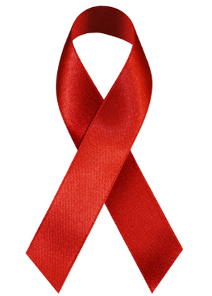
HIV Care in the United States
For every 100 people living with HIV…
80 are aware of their infection
62 are linked to HIV care
41 stay in HIV care
36 get antiretro- viral therapy
28 have a very low amount of virus in their body
SOURCE: New Hope for Stopping HIV. CDC Vital Signs, CDC, 2011.
Notes:
This image depicts that the state of HIV care in the United States. For every 100 people who are living with HIV, 80% are aware of their infection, 62% are linked with some form of HIV care, 41% stay in HIV care, 36% get ART, and 28% have a very low amount of virus in their body. If someone is unaware of their HIV status, it is important to encourage them to get an HIV test. If the test is positive, encourage them to get prevention counseling and medical care, stay in medical, and comply with their medication regimen. A lower amount of virus equates to better health, longer life, fewer new infections, and helping to stop the spread of HIV.

Slide 44
HIV Prevention Considerations
Many YMSM, gay and bisexual men with HIV are unaware they have it
  The Centers for Disease Control and Prevention (CDC) recommends that all YMSM, gay and bisexual men get tested for HIV at least once a year.
  Sexually active YMSM, gay and bisexual men may benefit from more frequent testing (e.g., every 3 to 6 months).
Sexual risk behaviors account for most HIV infections in gay and bisexual men. Most gay and bisexual men acquire HIV through anal sex, which is the riskiest type of sex for getting or transmitting HIV.
Notes:
CDC recommends that everyone between the ages of 13 and 64 get tested for HIV at least once as part of routine health care. A general rule for those with risk factors is to get tested annually. Additionally, sexually active gay and bisexual men may benefit from getting an HIV test more often, perhaps every 3 to 6 months. Data from a clinical trial sponsored by the National Institutes of Health indicate there is a clear personal health advantage to being diagnosed and starting therapy in the early course of HIV infection. This information further highlights the importance of routine HIV testing and its potential impact on better health outcomes.
For sexually active gay, MSM, and bisexual men, the most effective ways to prevent transmitting or becoming infected with HIV are to be on antiretroviral medications (to either treat or prevent infection) and to correctly use a condom every time for anal or vaginal sex. Gay men are at increased risk for sexually transmitted infections (STIs), like syphilis, gonorrhea, and chlamydia, and CDC recommends that all sexually active gay and bisexual men be tested at least annually for STIs and obtain treatment, if necessary.

Slide 45
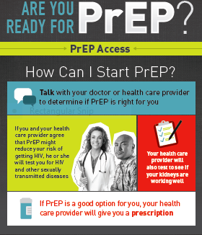
PrEP/PEP
Pre-exposure prophylaxis (or PrEP): people at high risk for HIV take HIV medicines daily to lower their chances of getting infected
The CDC reports that PrEP reduces the risk of getting HIV from by sex more than 90% (if taken daily)
Post-exposure prophylaxis (or PEP) means taking ART after being exposed to HIV to prevent infection
Notes:
Pre-exposure prophylaxis (or PrEP) is when people at very high risk for HIV take HIV medicines daily to lower their chances of getting infected. A combination of two HIV medicines (tenofovir and emtricitabine), sold under the name Truvada® (pronounced tru vá duh), is approved for daily use as PrEP to help prevent an HIV-negative person from getting HIV from a sexual or injection-drug-using partner who’s positive. Studies have shown that PrEP is highly effective for preventing HIV if it is used as prescribed. PrEP is much less effective when it is not taken consistently.
If you take PrEP daily, the presence of the medicine in your bloodstream can often stop HIV from taking hold and spreading in your body. If you do not take PrEP every day, there may not be enough medicine in your bloodstream to block the virus.
PrEP can be prescribed only by a health care provider, so talk to yours to find out if PrEP is the right HIV prevention strategy for you. You must take PrEP daily for it to work. Also, you must take an HIV test before beginning PrEP to be sure you don’t already have HIV and every 3 months while you’re taking it, so you’ll have to visit your health care provider for regular follow-ups.
The cost of PrEP is covered by many health insurance plans, and a commercial medication assistance program provides free PrEP to people with limited income and no insurance to cover PrEP care.
PEP (post-exposure prophylaxis) means taking antiretroviral medicines (ART) after being potentially exposed to HIV to prevent becoming infected. PEP should be used only in emergency situations and must be started within 72 hours after a recent possible exposure to HIV. If you think you’ve recently been exposed to HIV during sex or through sharing needles and works to prepare drugs or if you’ve been sexually assaulted, talk to your health care provider or an emergency room doctor about PEP right away.
For more information please visit www.cdc.gov/hiv

Slide 46
Medications for HIV Infection
HIV-positive people have many options for AIDS/HIV medications:
  Anti-HIV medications that treat HIV infection
  Drugs that treat side effects of the disease or HIV treatment
  Drugs that treat opportunistic infections that result from a weakened immune system
HIV Drugs - The FDA has approved more than 25 antiretroviral drugs to treat HIV infection. These medications can help to:
  Lower viral load
  Fight infections
  Improve quality of life
Notes:
KEY POINTS
Even when these HIV medications are effective, however, one can still transmit HIV to others. They are not a cure for HIV. Researchers are continuing to develop many new types of AIDS/HIV medications.
Additional Information for the Trainer(s)
Please refer to the following link for additional information: http://www.webmd.com/hiv-aids/aids-hiv-medication.

Slide 47

Where are we headed?
Treatment Goal by 2020
90% 90% 90%
When achieved:
at least 73% of all people living with HIV worldwide will be virally suppressed – an increase 2-3x current estimates.
If achieved by 2020, will bring a an end the AIDS epidemic by 2030.
Diagnosed On Treatment Virally Suppressed
Notes:
UNAIDS has an ambitious treatment target to help end the AIDS epidemic. By 2020, 90% of all people living with HIV will know their HIV status. By 2020, 90% of all people with diagnosed HIV infection will receive sustained antiretroviral therapy. By 2020, 90% of all people receiving antiretroviral therapy will have viral suppression.

Slide 48
Providers Considerations
When completing a sexual history or sexual health assessment, avoid assumptions and judgments.
Clients who are married may not be monogamous. Ask about sexual partners outside of marriage.
We cannot always rely on patients' self-reported identities to assess risk for HIV infection and sexually transmitted diseases.
We must inquire about behavior in a culturally appropriate manner.
Public health prevention messages must be crafted to explain the dangers of risky sexual behaviors in a manner that is effective with the targeted audience.
Notes:
It might be easy to skip or hurry though questions we might determine not applicable to our clients.
An example of this is making the assumption someone over the age of 50 is not sexually active, therefore skipping questions about sex and sexuality.
Another example is skipping questions about multiple partners if the client reports they are married.
Developing prevention messages that focus on risky sexual behaviors minimizes the shame and stigma associated with sexual orientation and reaches the widest possible audience.
Targeted messaging is recommended to reach specific communities. Use the assistance of the target audience to help develop messaging that best reflects the community’s needs. This is of particular importance for communities that have historically been underrepresented in HIV prevention social marketing campaigns (e.g. American Indian/Alaska Native peoples).

Slide 49

Substance Use and
Mental Health Issues
49
Notes:
This next segment of the module will explore substance use and mental health issues among YMSM.

Slide 50
Key Message
Substance use and mental health/psychosocial problems, both of which disproportionately affect LGBT/MSM populations, contribute to an increased risk of HIV and STI transmission.
We have very limited data on YMSM in this arena, but given the high rates of HIV transmission, it is reasonable to assume that we may see similar issues related to mental health and substance use problems.
50
Notes:
Evidence-based HIV prevention interventions with men who have sex with men (MSM) in the United States have moderate effect sizes in reducing HIV sexual risk behavior. Mental health and psychosocial problems, which both disproportionately affect MSM populations and are implicated in HIV transmission risk behaviors, also likely interfere with the uptake of HIV behavioral interventions. Moreover, given that mental health and psychosocial problems such as depression, substance use, and violence frequently co-occur for many MSM (eg, as “syndemic conditions”), what is probably needed are combination prevention efforts, or prevention “cocktails,” similar to treatment “cocktails,” that address the psychological and behavioral mechanisms that interact to produce elevated risk for HIV. Such interventions should incorporate a holistic framework to address the sexual health and overall well-being of MSM. Addressing co-occurring psychosocial risk factors is apt to improve effect sizes of current HIV prevention interventions and allow for more effective uptake by MSM.
REFERENCE:
Safren, S.A., Reisner, S.L., Herrick, A., Mimiaga, M.J., & Stall, R. (2010). Mental health and HIV risk in men who have sex with men. J Acquir Immune Defic Syndr, 55(Suppl 2), S74-S77.
Additional Information for the Trainer(s):
According to the work of Holloway and colleagues and Traube and colleagues, mental illness and substance use among young men who have sex with men occurs in the context of a variety of sociodemographic factors and issues, including poverty, racism, homophobia, limited health insurance, lack of transportation, homelessness, unemployment, limited education, and low health literacy.
REFERENCES:
Holloway, I.W., Shrager, S.M., Wong, C.F., Dunlap, S.L., & Kipke, M.D. (2014). Venue-based network analysis to inform HIV prevention efforts among young gay, bisexual, and other men who have sex with men. Prevention Science, 15, 419-427.
Traube, D.E., Schrager, S.M., Holloway, I.W., Weiss, G., & Kipke, M.D. (2013). Environmental risk, social cognition, and drug use among young men who have sex with men; Longitudinal effects of minority status on health processes and outcomes. Drug Alcohol Depend, 127, 1-7.

Slide 51

Alcohol/Drug Use Among LGBT/MSM
Studies have shown that, when compared with the general population, gay and bisexual men, lesbian, and transgender individuals are more likely to:
Use alcohol and drugs
Have higher rates of substance abuse
Not withhold from alcohol and drug us
Continue heavy drinking into later life
Notes:
According to the research that has focused on LGBT and MSM populations, studies have shown that they are more likely to use any alcohol and drugs, have higher rates of substance abuse, not withhold from alcohol and drug use, and continue heavy drinking later into life.

Slide 52
Disparities in Smoking, Alcohol Use, and Illicit Drug Use among YMSM
Only 17.6% reported no substance use during past 6 months
Black YMSM had lower prevalence of use of all substances except for marijuana compared to White YMSM
Latino YMSM had lower prevalence of alcohol, marijuana, and club drug use compared to Black and White YMSM
Bisexual YMSM reported higher prevalence of cigarette smoking, stimulant use, and club drug use compared to gay/mostly gay YMSM
SOURCE: Newcomb et al., 2014.
Notes:
In this study the demographic interview assessed participant age, race/ethnicity, sexual orientation, self-reported HIV status (confirmed with OraQuick HIV antibody test), living situation, and educational attainment. Participants self-reported sexual orientation as: “only gay/homosexual”, “mostly gay/homosexual”, “bisexual”, “mostly heterosexual”, “only heterosexual”, or “other”.
YMSM are substantially more likely to use illicit drugs and other substances as compared to heterosexual peers, including a higher prevalence of cigarette smoking, alcohol use and binge drinking, and illicit drug use. Substance use during adolescence has critical implications for long-term physical and mental health, and among YMSM may lead to HIV infection.
Additional Information for the Trainer(s):
According to data from Project EXPLORE (Marshall et al., 2015), younger age, self-identifying as white, lower educational attainment, depressive symptoms, and stimulant use were associated with reporting heavier drinking trajectories among MSM. Interventions to reduce heavy drinking among MSM should seek to mitigate the adverse effects of low attainment, depression, and early traumatic life events on the initiation, continuation, or escalation of frequent heavy drinking.
YMSM may be at particularly high risk for engaging in risky sexual behavior while under the influence of drugs. Mustanski and colleagues found a positive association between “any drug use” and sexual risk in YMSM; and use of club drugs and unprotected anal intercourse (UAI) in a general MSM (not youth-specific) population.
With regards to substance use among Asian/Pacific Islander YMSM, Operario and colleagues found that 24% used an illicit substance weekly or more often, 51% used club drugs, and 44% used three or more illicit substances. Associations between substance use and sexual risk behaviors also emerged.
REFERENCE:
Newcomb, M.E., Ryan, D.T., Greene, G.J., Garofalo, R., & Mustanski, B. (2014). Prevalence and patterns of smoking, alcohol use, and illicit drug use in young men who have sex with men. Drug and Alcohol Dependence, 141, 65-71.
Marshall, B.D.L., Kahler, C.W., Koblin, B.A., Mayer, K.H., Mimiaga, M.J., van den Berg, J.J., Zaller, N.D., & Operario, D. (2015). Heavy drinking trajectories among men who have sex with men: A longitudinal, group-based analysis. Alcoholism: Clinical and Experimental Research, 39(2), 380-389.
Mustanski, B.S., Newcomb, M.E., Du Bois, S.N., Garcia, S.G., & Grov, C. (2011). HIV in young men who have sex with men: A review of epidemiology, risk, and protector factors, and interventions. Journal of Sexual Research, 48(2-3), 218-253.
Operario, D., Choi, K-H., Lee Chu, P., McFarland, W., Secura, G.M., Behel, S., MacKellar, D., & Valleroy, L. (2006). Prevalence and correlates of substance use among young Asian Pacific Islander men who have sex with men. Prevention Science, 7(1), 19-29.

Slide 53

Stimulant Use among Racial/Ethnic Minority MSM Social Networking Users
Participants reported high rates of cocaine and methamphetamine use (both over 15% within past year)
80% reported using social media to meet people
30% used social media to find sex partners
  Participants who used social networks to find sex partners were more likely to have used methamphetamines in last year
  Those who were more comfortable talking online (vs. face-to-face) had 4x the odds of reported meth use and over 6x the odds of cocaine use
SOURCE: Young & Shoptaw, 2013.
Notes:
High stimulant-using and at-risk HIV populations, such as African American and Latino men who have sex with men (MSM), are increasingly using social networking technologies. Young and Shoptaw conducted the first research study to explore the associations between stimulant use, sexual risk behaviors, and social networking among these populations. The sample was comprised of 118 primarily African American and Latino MSM active Facebook users. Minority MSM who engaged social networks to meet men and find sex partners had high risk for stimulant use. It is critical to understand drug use among minority social networking users to provide insights to incorporate these technologies into drug prevention interventions.
Reference:
Young, S.D., & Shoptaw, S. (2013). Stimulant use among African American and Latino MSM social networking users. Journal of Addictive Diseases, 32(1), 1-11.

Slide 54
Critical Considerations
Substance use among some gay/bisexual men can be a reaction to homophobia, discrimination, or violence and can contribute to other mental health and physical health problems.
For some gay/bisexual men, alcohol and illegal drug use, especially methamphetamines (meth), amyl nitrates (poppers), and drugs used to treat erectile dysfunction also contribute to a higher chance of getting HIV and other STIs.
To the extent that YMSM experience similar homophobia, discrimination and violence, we would expect similar kinds of relations. It is important to assess for these factors and for degree of substance use in association with sexual behaviors with male and female partners.
Notes:
Alcohol and drug use among some gay and bisexual men can be a reaction to homophobia, discrimination, or violence they experienced due to their sexual orientation and can contribute to other mental health and physical health problems. Ultimately, it can disrupt relationships, employment, and threaten financial stability.
For some gay and bisexual men, alcohol and illegal drug use, especially methamphetamines (meth), amyl nitrates (poppers), and drugs used to treat erectile dysfunction (when a man has a hard time keeping an erection during sex), also contribute to a higher chance of getting HIV and other STIs. Persons using drugs or alcohol may also raise their chances of getting HIV or giving it to others by getting involved in more risky sexual practices and behaviors or through sharing needles or other injection equipment.

Slide 55

Mental Health Among LGBT/MSM
Ongoing homophobia, stigma (negative and usually unfair beliefs), and discrimination (unfairly treating a person or group of people) can have negative effects on your health. Research has shown that, compared to other men, gay and bisexual men have higher chances of having:
-Major depression
-Bipolar disorder
-Generalized anxiety disorder
Notes:
Gay and bisexual men are more likely to be diagnosed with major depression, bipolar disorder, and generalized anxiety disorder.

Slide 56
Mental Health and HIV Risk
Mental illness may increase the risk of HIV infection in several ways:
  MI can decrease the salience of other health threats such as HIV, so that individuals with mental illness are often less informed about risk;
  MI can negatively impact the social and interpersonal skills that are required to negotiate safe sex, thus leaving individuals vulnerable to sexual coercion and more likely to engage in sexual risk behavior;
  Thus, although individuals with mental illness tend to engage in fewer occasions of sexual intercourse compared to other subgroups, they often engage in risky sexual practices, such as having multiple or high risk partners, sex trading, and having unprotected penetrative sex
Notes:
Mental health issues may help to increase the risk of HIV infection in a variety of ways.

Slide 57
Mental Health and
Sexual Risk among YMSM
Studies focused on the association between depression and sexual risk taking among YMSM have found the following:
Higher depression symptom scores = more sexual partners
Longitudinal research indicates that improvements in symptoms of depression relate to improved patterns of sexual risk behavior over time.
SOURCE: Mustanski et al., 2011.
Notes:
The association between mental health and sexual risk has been explored more extensively among adult MSM, with a limited number of studies focusing specifically on YMSM. In a review by Mustanski and colleagues, it was noted that individuals with higher depression scores had more sexual partners as compared to low depression symptom scorers. In addition, samples of sexual minority youth comprised partially or solely of YMSM have demonstrated increased risk for suicidal ideation and attempts, PTSD, behaviors associated with eating disorders, and generalized anxiety disorder and conduct disorder.
Mustanski (2007) found an association between psychological distress and unprotected anal intercourse in an urban YMSM sample.
REFERENCE:
Mustanski, B.S., Newcomb, M.E., Du Bois, S.N., Garcia, S.G., & Grov, C. (2011). HIV in young men who have sex with men: A review of epidemiology, risk, and protector factors, and interventions. Journal of Sexual Research, 48(2-3), 218-253.
Mustanski, B. (2007). The influence of state and trait affect on HIV risk behaviors: A daily diary study of MSM. Health Psychology, 26(5), 618-626.

Slide 58
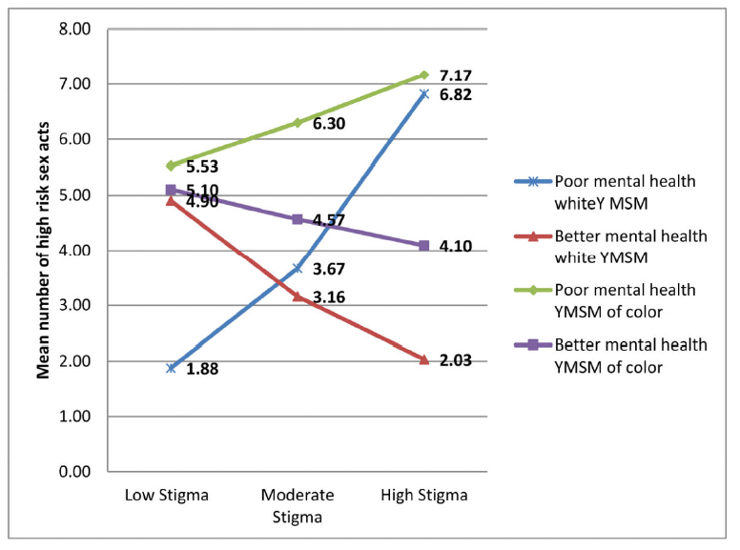
Impact of Mental Health Status and Stigma/Stress on Prevalence of High-Risk Sex Acts among YMSM
SOURCE: Lelutiu-Weinberger et al., 2015
Notes:
Lelutiu-Weinberger and colleagues examined race-based differences in gay-related stress in conjunction with the moderating role of mental health on substance use and sexual risk among 206 high-risk YMSM recruited September 2007–2010. When they looked specifically at the impact of stigma/stress and mental health issues on the number of high risk sex acts, they found that white YMSM with low gay-related stigma scores and poorer mental health reported fewer high risk sex acts than white YMSM with low gay-related stigma scores and better mental health (M=1.87 vs. M=4.90). As gay-related stigma increases, white YMSM with poorer mental health had greater odds of engaging in high risk sex acts compared to white YMSM with better mental health, for whom a reduction in sexual risk occurred rather than an increase (M=6.82 vs. 2.03). For YMSM of color, those with low gay-related stigma scores, regardless of their mental health status, reported similar numbers of high risk sex acts (M=5.52 and M=5.10). Those with poorer mental health were at higher odds of engaging in high risk sex with increasing stigma, while those with better mental health had less risky sex as stigma increased (M=7.1 vs. M=4.09).
All YMSM with poor mental health reported increasing sex risk with increasing stigma, and all YMSM with better mental health reported decreasing sex risk with increasing stigma. Second, YMSM of color reported more sex risk than white YMSM regardless of mental health, and had less of a decrease in high risk sex with improving mental health than their white counterparts. Third, white YMSM with poor mental health evidenced a sharper increase in sex risk with increasing stigma compared to YMSM of color, while white YMSM with better mental health evidenced a sharper decrease in sex risk with increasing stigma compared to YMSM of color.
Reference:
Lelutiu-Weinberger, C., Gamarel, K.E., Golub, S.A., & Parsons, J.T. (2015). Race-based differentials of the impact of mental health and stigma on HIV risk among young men who have sex with men. Health Psychology, 34(8), 847-856.

Slide 59
Revealing Sexual Orientation “Coming Out”
Keeping your sexual orientation hidden from others (being "in the closet") and fear of having your sexual orientation disclosed (being “outed”) can add to the stress of being gay or bisexual.
In general, research has shown that gay and bisexual men who are open about their sexual orientation with others have better health outcomes than gay and bisexual men who do not.
However, being “out” in some settings and to people who react negatively can add to the stress experienced by gay and bisexual men, and can lead to poorer mental health and discrimination.
YMSM may not identify as being gay or bisexual or even use the label YMSM. YMSM may feel all of these stressors associated with disclosure and secret keeping as well.
Notes:
The term “coming out” (of the closet) refers to the life-long process of the development of a positive gay, lesbian, bisexual, or transgender identity. For many people, it can be a very long and difficult struggle, because of the need to confront homophobic attitudes and discriminatory practices along the way. Many individuals first need to struggle with their own negative stereotypes and feelings of homophobia that they learned when they were growing up.

Slide 60
The Coming Out Process
“The loneliness of the closet was sucking all the life out of my body…I needed to come out…but was terrified of losing my family and friends and of facing up to my own homophobia. Then one day, when I was feeling feisty, I gathered all of the courage I could find (even from my eyelids I think) and began to tell my long-kept secret. I felt so relieved I no longer had to spend my life in hiding...”
--20 year old Latino man
Notes:
The term "coming out" refers to the experiences of lesbians and gay men as they work through and accept a stigmatized identity, transforming a negative self-identity into a positive one.

Slide 61
“Coming Out” and Familial Dynamics
Younger Men who have Sex with Men cross sexual milestones at earlier ages during which they are highly dependent on family for basic needs.
Coming out “early” has been connected with experiencing forced sex, gay related harassment, HIV seropositivity, partner abuse, and depression.
Youth of color are significantly less likely to tell their parents they are LGBT
  80% of LGBT whites are out to parents vs. 71% of Latinos, 61% of African Americans, and 51% of Asians/Pacific Islanders
  African American same-sex attracted youth were more likely to have low self-esteem and experience suicidal thoughts than ethnic counterparts
  African American same-sex attracted men were more likely to be depressed
SOURCE: Friedman et al., 2008.
Notes:
Sexual milestones are defined as topics that are challenging to talk to family about or youth are unable to talk to their families about. Younger MSM were crossing sexual milestones at earlier ages which often coincides with when they are highly dependent on their families for food, shelter, and social/emotional support. Coming out “early” has been connected with experiencing forced sex and gay- related harassment before adulthood, HIV seropositivity, partner abuse, and depression during adulthood. Negative outcomes likely driven in part by family rejection, evidenced as poor familial support, being harassed by family members because of sexual identity, and/or being kicked out of the home.
REFERENCE:
Friedman, M.S., Marshal, M.P., Stall, R., Cheong, J.-W., & Wright, E.R. (2008). Gay-related development, early abuse, and adult health outcomes among gay males. AIDS Behavior, 12(6), 891-902.

Slide 62
Age of Sexual Debut and Associated Risk Factors among Racial/Ethnic Minority YMSM
Participants having a sexual debut before the age of 16 reported:
  More exchange sex
  More drug use (marijuana)
  More emotional and psychological problems related to substance use
  More history of suicide attempts
No differences were seen in rates of unprotected sex
SOURCE: Outlaw et al., 2011.
Notes:
According to Outlaw et al. (2011), the average reported age of sexual debut for youth in the United States is 14.4 years, with approximately 7% reporting their sexual debut prior to age 13. While the research literature on sexual debut for youth addresses gender and ethnic differences (with males and African-American youth experiencing earlier sexual debut), there is limited data regarding factors associated with sexual debut for YMSM. Outlaw and colleagues sought to investigate risk behaviors and emotional distress and their association with MSM sexual debut for a cohort of racial and ethnic minority YMSM living with HIV. They hypothesized that those with a sexual debut prior to the age of 16 would have higher rates of high-risk sexual behaviors, substance use, and emotional distress than those with a sexual debut at age 16 or older. No differences were seen in the rate of unprotected sex. Outlaw and colleagues conclude that interventions that are racially/ethnically sensitive, inquire about initial sexual experiences, and focus on sexual health and healthy relationships are critical to improve the health outcomes for racial and ethnic minority YMSM who are living with HIV.
Reference:
Outlaw, A.Y., Phillips, G., Hightow-Weidman, L.B., Fields, S.D., Hidalgo, J., Halpern-Felsher, B., Green-Jones, M., and the Young MSM of Color SPNS Initiative Study Group. (2011). Age of MSM sexual debut and risk factors: Results from a multisite study of racial/ethnic minority YMSM living with HIV. AIDS Patient Care and STDs, 25(Supplement 1), S23-S29.

Slide 63
Bobby Griffith
“I can’t let anyone find out that I’m not straight. It would be so humiliating. My friends would hate me, I just know it. They might even want to beat me up…I guess I’m no good to anyone…not even God. Life is so cruel, and unfair. Sometimes I feel like disappearing from the face of this earth.”
(2 weeks before his death by suicide)
Notes:
Bobby Griffith, was a young gay man who killed himself in 1983 due to his mother's homophobia. A book was written about the his story (and a TV film was made based on the book). His mother, Mary Griffith, had tried throughout her son's adolescence to "pray away" his "gay nature". At age 20, Bobby Griffith jumped to his death from a freeway bridge in Portland Oregon. Mary was transformed by her loss and eventually renounced the rigid religious beliefs that had kept her from fully accepting Bobby during his lifetime.

Slide 64

Suicide Risk among LGBT/MSM Youth
64
Notes:
This next segment of the module will explore suicide among MSM/LGBT youth.

Slide 65

LGBT Youth Suicide Risk
More risk factors or more severe ones:
  Unsafe school
  Rejection/abuse within family
  Victimization/bullying
  Previous attempts
  Exposure to suicide loss
  Gay-related stress and minority stress
  Gender non-conformity
  Internal conflict regarding sexual orientation
Notes:
We don’t have data on suicide risk among YMSM. Some may experience none of these risks, but many may. Assessing for the presence of these risk factors is essential to adequately care for their wellbeing.

Slide 66
Suicidality among YMSM
Gay, bisexual, and YMSM are more likely than other men to have tried to commit suicide and to have died by suicide.
One-third of all survey respondents reported at least one suicide attempt
4.7% attempted suicide in the past year
Although suicide attempts were more prevalent among African Americans and urban residents, only non-school enrollment was significantly associated with suicide attempts
Notes:
This study corroborates the findings of prior studies of high rates of suicide attempts among YMSM. In addition, it demonstrates that attempts are more prevalent among out-of-school youths.
In 1998, Remafedi and colleagues found that 28.1% of gay or bisexual males in grades 7 through 12 had attempted suicide at least once during their lives, while only 4.2% of heterosexual males in those grades had attempted suicide. Garofalo and colleagues (1999) found that high school students identifying as either LGB or not sure of their sexual orientation were 3.4 times as likely to have attempted suicide within the last 12 months as their heterosexual peers.
REFERENCE:
Remafedi, G. (2002). Suicidality in a venue-based sample of young men who have sex with men. Journal of Adolescent Health, 31, 305-310.
ADDITIONAL RESOURCE:
Suicide Prevention Resource Center. (2008). Suicide Risk and Prevention for Lesbian, Gay, Bisexual, and Transgender Youth. Newton, MA: Education Development Center, Inc.

Slide 67
a male youth
(parental disappointment)
“Then [my mother] hit me with this clincher that always gets a lot of kids…‘I thought I’d raise someone who would grow up to be someone I could count on, someone who I could be proud of’ …That is one thing that can really lead you to hopelessness, like ‘what good am I, I did not meet the standards?’”
Notes:
A qualitative investigation of the contributors to the rate of suicide attempts among youth who identify as lesbian, gay, bisexual, and transgender. Unclear whether youth was gay, bisexual, or transgender.
Jennifer M. Meunier, MPH.

Slide 68
a male youth
(religious persecution)
“I felt less in the eyes of God like I was going to be judged, and it’s kind of hard when you feel like you have an impending axe above your head.”
Notes:
A qualitative investigation of the contributors to the rate of suicide attempts among youth who identify as lesbian, gay, bisexual, and transgender. Unclear whether he was gay, bisexual, or transgender.
Jennifer M. Meunier, MPH.

Slide 69
19-year-old Adam
(ongoing pressure of hiding)
“I got way too close to suicide when I was in the closet. I hated my life. I was tired of lying, and of being afraid…One night, I found myself with a knife in my hand, and I thought, ‘Nothing can hurt more than this.’…I realized that I could die anytime, but I could only live once. So I chose to come out. It was difficult, but I did it. And the pain stopped. It was like breathing for the first time.”
Notes:
The shared heart: Portraits and stories celebrating lesbian, gay, and bisexual young people. (1997). By Adam Mastoon.

Slide 70
a gay male youth
(support makes a big difference)
“I mean my family stands behind me 100 percent…I’m actually letting out who I am and I’ve become more responsible and respectful of people around me because I’m gay.”
Notes:
A qualitative investigation of the contributors to the rate of suicide attempts among youth who identify as lesbian, gay, bisexual, and transgender. Unclear whether youth was gay, bisexual, or transgender.
Jennifer M. Meunier, MPH.

Slide 71
Tool Kit
Suicide Prevention among LGBT Youth: A Workshop for Professionals Who Serve Youth
  The Suicide Prevention Resource Center’s new workshop kit helps staff in schools, youth-serving organizations, and suicide prevention programs take action to reduce suicidal behavior among lesbian, gay, bisexual, and transgender youth.
  It contains everything you need to host a workshop: a Leader's Guide, agendas, presentations, scripts, and handouts, in addition to lectures, small group exercises, and discussion.
  Not specific to YMSM – information still applicable.
  Available at: http://www.sprc.org/training-institute/lgbt-youth-workshop
Notes:
Suicide Prevention among LGBT Youth: A Workshop for Professionals Who Serve Youth, developed by the Suicide Prevention Resource Center, is a free kit of materials to help staff in schools, youth-serving agencies, and suicide prevention programs provide a workshop on suicide prevention among LGBT youth. Individuals attending this workshop may include teachers, school administrators, child welfare staff, clergy, group home staff, juvenile justice staff, foster parents, therapists, and recreation workers.
Topics covered include suicidal behavior among LGBT youth, protective factors for suicidal behavior, strategies to reduce suicide risk, and ways to increase school or agency cultural competence. Materials in the kit include a PowerPoint slide presentation, leader’s guide, and handouts. Instructional methods include lecture, small group exercises, and group discussion. The workshop kit provides a foundation from which leaders can adapt the workshop to meet their needs and the needs of their audience. Leaders are welcome to shorten or lengthen the workshop from the suggested 4-hour format. They may also add materials specific to local programs, resources, or activities.

Slide 72

Homelessness
72
Notes:
This next segment of the module will explore homelessness among YMSM/LGBT youth.

Slide 73
Homelessness and YMSM
A disproportionate number of LGBT youth are homeless
  While only about 3-5% of the population is estimated to be LGBT, 42% of homeless youth are LGBT
  An estimated 65% of homeless people are members of racial minorities
Both a prior experience of homelessness and currently being homeless are both strongly associated with higher levels of lifetime and current exposure to drug and sexual risk
  Onset of the risks occur earlier in both groups that have had an experience of housing instability
Homeless or marginally housed YMSM of color are at particular risk for substance use and HIV transmission
SOURCES: Tucker et al., 2012; Clatts et al., 2005.
Notes:
Housing instability includes runaway, foster care, etc.
Overall, the sample evidences high levels of exposure to a broad range of illegal drugs, including marijuana (82%), crack-cocaine (15%), powder cocaine (39%), heroin (13%), speed (23%), MDMA (50%), ketamine (29%), and hallucinogens (28%). 7% (N ¼ 39) report lifetime exposure to injection drug use. YMSM also report high rates of current use of one or more of these substances, including marijuana (60%), crack-cocaine (6%), powder cocaine (15%), heroin (4%), Speed (9%), MDMA (22%), ketamine (10%), and hallucinogens (2%). Additionally, 3% of the overall sample report current use of injection as a mode of drug administration (IDU). Rates of
both lifetime exposure and current drug use are not equally distributed in the sample. Relative to the never homeless and past homeless groups, currently homeless evidence still greater prevalence of lifetime exposure to current use of drugs, including crack cocaine (36%), powder cocaine (42%), heroin (28%), Speed (23%), MDMA (35%), ketamine (21%), and hallucinogens (35%). An alarming 15% of the currently homeless group report some kind of lifetime exposure to IDU. Moreover, currently homeless YMSM report higher levels of ongoing (current) use of many of these substances, including crack-cocaine (18%), powder cocaine (16%), heroin (14%), Speed (8%), and MDMA (15%). 10% of the currently homeless group report current IDU. YMSM who are currently homeless are more likely than those who have never been homeless to be currently using crack-cocaine, heroin, and IDU. YMSM who are currently homeless are more likely than those with a past history of homelessness to be currently using crack-cocaine, powder cocaine, heroin, and IDU.
REFERENCES:
Clatts, M.C., Goldsamt, L., Yi, H., & Viorst Gwadz, M. (2005). Homelessness and drug use among young men who have sex with men in New York City: A preliminary epidemiological trajectory. Journal of Adolescence, 28, 201-214.
Tucker, J.S, Hu, J., Golinelli, D., Kennedy, D.P., Green, H.D., et al. (2012). Social network and individual correlates of sexual risk behavior among homeless MSM youth. J Adolescent Health, 51, 386-392.

Slide 74
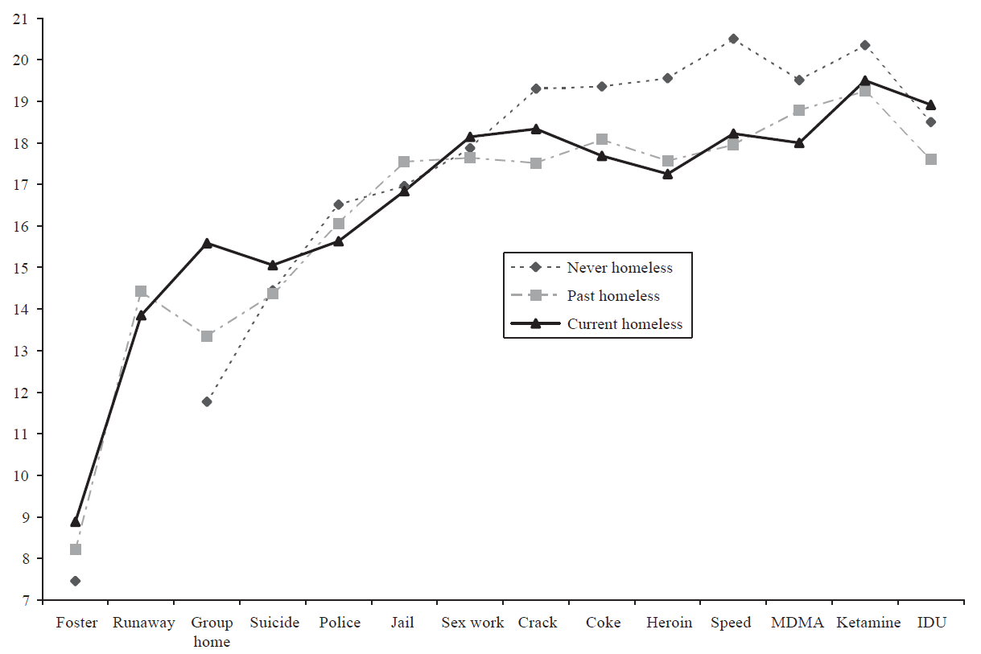
Life Trajectory of
Onset of Negative Events among YMSM
Prior experience of homelessness and currently being homeless are both strongly associated
both higher levels of lifetime exposure to drug and sexual risk
higher levels of current drug and sexual risk.
Onset of these risks occur earlier but are delayed or not present among YMSM with no history of housing instability.
SOURCE: Clatts et al., 2005.
Notes:
Lines on the graph represent age. So, the lower the down the marker is, the younger the person was when that life event occurred. For current and formerly homeless YMSM, negative life events happened earlier than for never homeless group. This indicates that, at minimum, there is a complex relationship between these life events and homelessness that needs to be understood. It also seems to indicate that these life events may directly influence the advent of homelessness, rather than being caused by it.
Many people think that homelessness causes many of the negative life events experienced by homeless people. However, this graph indicates the opposite. The lines represent The trajectory data show that the timing of negative events occurs in a relatively consistent order, notably one that betrays many of the assumptions in the existing homeless youth literature which poses negative behavioral practices such as involvement in drug use or sex work as a causal factor in youth becoming homeless. Across all three groups, the data show a consistent temporal pattern in which a constellation of negative life events occur before the onset of both drug use and sex work. Moreover, negative outcomes occur earlier for the two groups with exposure to homelessness relative to the group with no exposure to homelessness. For both the past homeless and current homeless groups, foster care, running away from home, and living in a group home, on average, all occur at the earliest chronological ages (mean ages of 8.6, 14.2, 14.5, respectively).
REFERENCE:
Clatts, M.C., Goldsamt, L., Yi, H., & Viorst Gwadz, M. (2005). Homelessness and drug use among young men who have sex with men in New York City: A preliminary epidemiological trajectory. Journal of Adolescence, 28, 201-214.

Slide 75
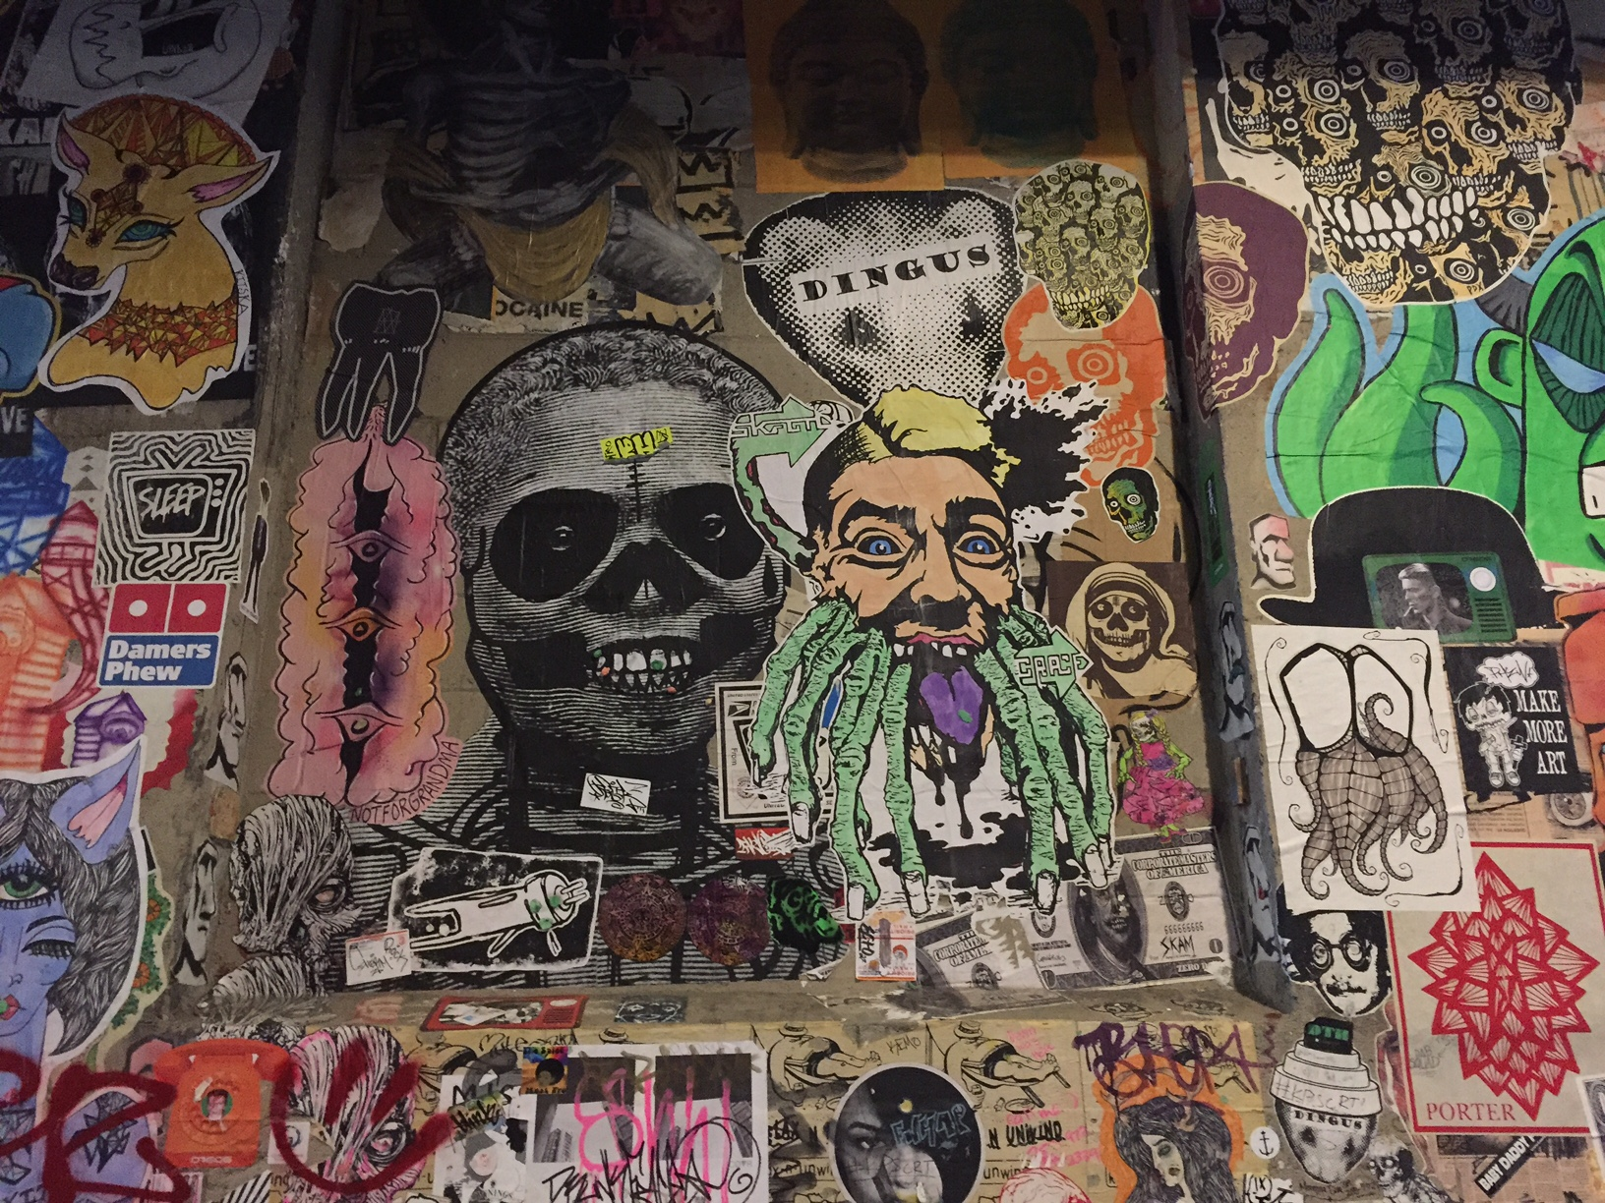
Violent Victimization Of LGBT/YMSM
75
Notes:
This next segment of the module will explore violent victimization of YMSM/LGBT youth.

Slide 76
The Impact of Bullying
Attack on physical safety and basic needs
Assault on a sense of belonging
Destroys sense of belonging
  Especially, when unrecognized
  Multifactorial when electronic
At its core, is an attack of one’s sense of self
Self-
Actualization
Self-Esteem
Love & Belonging
Safety & Security
PHYSIOLOGICAL
Biological/Physiological
Notes:
This slide illustrates the impact on bullying. The pyramid shows the core that makes up one’s sense of self. Bullying affects each level.

Slide 77
Incidence and Risk Factors for Sexual Orientation-Related Physical Assault among YMSM
16% of YMSM reported ever experiencing assault related to actual or perceived sexual orientation
Incidence was 2.3 per 100 person-years
Cumulative incidence (at 6-year follow-up) was 10.8 per 100 person-years
Increased risk was observed among MSM 23 years or younger and those who previously experienced assault.
The majority of LGBT youth of color have experienced victimization in school
  50% reported being victimized because of both race and sexual identity
  More than one-third had experienced physical violence because of their orientation
SOURCE: Lampinen et al., 2008.
Notes:
Lampinen and colleagues sought to determine the incidence of, prevalence of, and risk factors for sexual orientation–related physical assault in YMSM. They found that 16% of YMSM reported ever experiencing assault related to actual or perceived sexual orientation. An increased risk of incident sexual orientation-related physical assault was observed among MSM who were 23 years old or younger.
REFERENCE:
Lampinen, T.M., Chan, K., Anema, A., Miller, M.L., Schilder A.J., Schecter, M.T., Hogg, R.S., & Strathdee, S.A. (2008). Incidence of and risk factors for sexual orientation-related physical assault among young men who have sex with men. American Journal of Public Health, 98, 1028-1035.

Slide 78
Domestic Violence and Assault
MSM who are victims of intimate partner violence (IPV) are more likely to:
      Engage in substance use
      Suffer from depressive symptoms
      Be HIV positive
      Engage in unprotected anal sex
MSM who perpetrate IPV are more likely to engage in substance use
SOURCE: Buller et al., 2014.
Notes:
MSM who are victims of IPV are more likely to engage in substance use, suffer from depressive symptoms, be HIV positive, and engage in unprotected anal sex. MSM who perpetrate IPV are more likely to engage in substance use. The results of this meta-analysis highlight the need for research into effective interventions to prevent IPV in MSM, as well as the importance of providing health care professionals with training in how to address issues of IPV among MSM and the need to raise awareness of local and national support services.
REFERENCE:
Buller, A.M., Devries, K.M., Howard, L.M., & Bacchus, L.J. (2014). Associations between intimate partner violence and health among men who have sex with men: A systematic review and meta-analysis. PLoS Med, 11(3), e1001609.

Slide 79
Best Practices for Working Effectively with Culturally Diverse Clients
MODULE 3
79
Notes:
The context for this module is for health care provides to recognize that cultural competence is a factor that directly impacts engagement and retention of YMSM and LGBT people in care.

Slide 80
Goal of Module
To define cultural competence, humility, proficiency and identify & incorporate practices that engage and retain YMSM in care
To identify at least 2 strategies for culturally effective interactions and at least one practice behavior that will be used after the training
Notes:
Trainer reviews the goals of the module by informing participants that at the end of Module on YMSM & LGBT Cultural Competence, they will be able to:
To define cultural competence, humility, proficiency and identify & incorporate practices that engage and retain YMSMs in care
b) To identify at least 2 strategies for culturally effective interactions and identify at least one practice behavior that will be used after the training

Slide 81
Key Concept
Meet your clients where they are at!!!!
Notes:
The trainer invites the large group to respond to this concept and encourages them to state what it means in relation to effectively working with racial and ethnic minority men who have sex with men.
The trainer states: To “meet people where they are” we have to create and offer an opportunity/space for people to tell us where and who they are. A deeper understanding of culture can help us engage and retain the young men we serve.

Slide 82

What Is
…an integrated pattern of human behavior that includes thoughts, communications, languages, practices, beliefs, values, customs, courtesies, rituals, roles, relationships, manners of interacting, and expected behaviors of a racial, ethnic, religious or social group.
National Center on Cultural Competence, http://www.nccccurricula.info/glossary.html
Notes:
The trainer will facilitate a large group discussion and start by asking the participants to share their definition of culture. Then the trainer will show this slide and ask for reactions, comments. The trainer will make the following key points:
-culture is a structure and it is broad, “western civilization” and it can also be as specific as what your parents taught you in your house, “always look good when you go out”.
-cultures decide who has and does not have power. Some behaviors are rewarded with power and others are not, men engaging in sexual behaviors with the opposite sex is rewarded, affirmed and publically sanctioned in some cultures.
-each individuals experience of their culture(s) is unique.
Trainer may want to invite the group to define ‘race’ and ‘ethnicity’ before advancing to the next slide.

Slide 83
Dynamics of Culture
Dynamics
of Culture
Notes:
Culture is dynamic, alive and had a lot of moving parts and influences.

Slide 84
Cultural Patterns
Can be used to understand groups of people
These patterns are not frozen, or static, but open to exceptions since many individuals have experiences that are not shared by their group.
Notes:
The trainer reviews this slide and invites comments and reactions from the participants.
The trainer makes the following key point.
A pattern is not an individual. Our work is to seek to understand the individual and their culture(s).

Slide 85
Cultural Competence
A set of congruent behaviors, attitudes, and policies that come together in a system, agency, or among professionals that enables effective work in cross-cultural situations
US Department of Health & Human Services, Office of Minority Health, http://minorityhealth.hhs.gov/templates/browse.aspx?lvl=2&lvlid=11
Notes:
The trainer process and takes apart this broad definition of Cultural Competence with the large group and facilitates a dynamic discussion.
The trainer can also use the below content to supplement the discussion with an emphasis on “developmental process”, and “over an extended period”. Cultural competence is a journey that does not end in a fixed destination.
Cultural competence is a developmental process that evolves over an extended period. Both individuals and organizations are at various levels of awareness, knowledge and skills along the cultural competence continuum. (adapted from Cross et al., 1989)

Slide 86

“Cultural Humility” Perspective
“Lifelong process of learning, self-examination & refinement of one’s own awareness, knowledge, behavior and attitudes on the interplay of power, privilege and social contexts”
Tervalon, M. & Murray-Garcia, J. (1998, Journal of Health Care for the Poor and Underserved, 9(2), 117
Notes:
Cultural Humility developed out of the nursing profession, as a way to eliminate the power dynamics between patient and provider.
However, when we use “cultural humility” as an approach to effectively engage individuals, we recognize we (in our helping role) are not better than the people we have an opportunity to provide services for, and they teach us about their lives and community.
Tenants of Cultural Humility:
A lifelong commitment to self-evaluation and critique.
Understanding life is a learning process.
Redress (make right) the power imbalances in the provider-client dynamic.
Develop mutually beneficial, non-paternalistic partnerships with communities on behalf of individuals and defined populations.
Providers remain open to learning.
Understanding and accept we can never be truly “competent” in another’s culture.
Challenge yourself in identifying your own values as not the “norm.” (Tervalon & Murray-Garcia, 1998)

Slide 87



Male or Female?
Gay or Straight?
Cisgender or Transgender?
Unconscious Bias
Gender Shock: Exploding the Myths of Male and Female
Book by Phyllis Burke
Notes:
**ANIMATION**
This slide illustrates unconscious bias; participants answer the questions in the binary without even realizing it.
Move forward to reveal first picture which shows half of a face and move forward to reveal the questions for the audience to consider (male or female, gay or straight, cisgender or transgender).
Move forward to reveal second picture which shows a “female” version of the face.

Slide 88
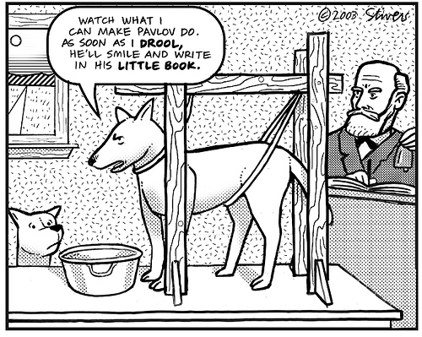
Conditioning - Activity
Large group activity
Follow trainer’s instructions
Notes:
The trainer can review the following suggested activities that focus on “conditioning” in a fun not threatening way. The what color is this paper should be done and done last before moving to the next slide.
The key message to communicate is, our conditioning can cause us to respond in ways that are reactive and reflexive and may not be culturally competent.
Say Roast, Roast, Roast out loud, Ask the group, What do you put in a toaster?
Trainer: Spell "hop."
Group: H-O-P
Trainer: Spell "mop."
Group: M-O-P
Trainer: Spell "top."
Group: T-O-P
Trainer: What do you do at a green light?
Group: (Accustomed to the "op" sound) Stop.
Trainer: No, you go at a green light!
“Spell SILK!" - "Now, what does a cow drink?"
What color is this paper, ask 5 times, get them to say it loud (use a white paper).
Ask the group, What do cows drink?

Slide 89

Perceptions Paradigm
Cues
Filters
Perceptions
Assumptions
Behavior
Notes:
As human beings providing services to other human beings, young men who have sex with man and LGBT people, that is a strength; our field is called “Human Services”. Our personal humanness/experience can also be a limitation when providing services to others if left unexamined.
Our personal individual history, associations, and experiences can conspire and make us blind. All human beings have blind spots. Blind spots are normal and don’t have to lead to permanent cultural blindness.
The process of developing and practicing cultural competence can bring new vision and insight. The process can allow you to see people in ways you were not able to before.
Creating a safe, welcoming and accepting space for young men who have sex with men and LGBT people, and being active about enhancing your self awareness are two critical steps in the process of practicing cultural competence.

Slide 90
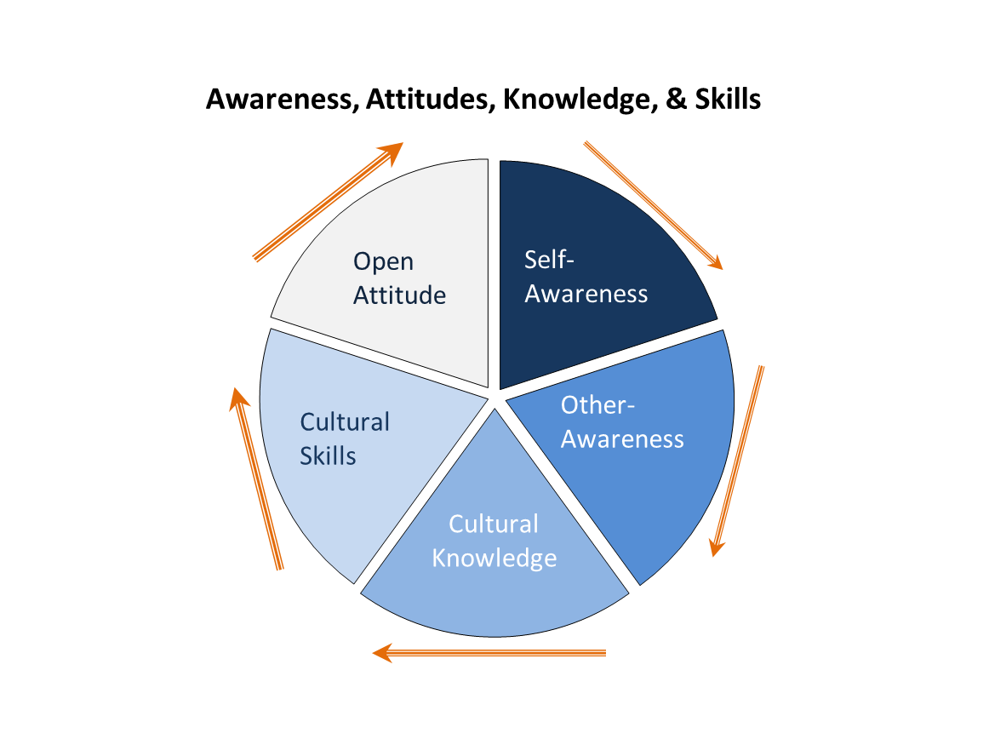
Conceptual Framework
Adapted from a Treatment Improvement Protocol, Improving Cultural Competence, TIP 59 http://store.samhsa.gov/shin/content//SMA14-4849/SMA14-4849.pdf
Notes:
The trainer will review this process diagram with a focus on self-awareness and reinforcing cultural competence as a process engaged in over time fueled by specific actions.

Slide 91
Cultural Proficiency
Cultural proficiency is the knowledge, skills, attitudes and beliefs that enable people to work well with, respond effectively to, and be supportive of people in cross-cultural settings.
Critical to the engagement & retention of YMSM & LGBT people
  Can help practitioners begin to address individual and societal history; e.g., experiences of murder, violence, rejection, degradation, & discrimination
Notes:
From a “cultural humility” perspective we will never be “culturally competent”; what we strive for is “cultural proficiency”. This is a practice stance and set of behaviors that we choose to use that make it possible for us to engage and work with people that are different than us in obvious and unseen ways.
The practice of cultural proficiency can be particularly meaningful and positively impactful when working with YMSM and LGBT people and can sometimes help with the resolution of traumatic and violating past experiences.

Slide 92

Practice Strategies
92
Notes:
We are now going to look at “practice strategies”.
Before we do, let’s talk about conditioning and human blind spots.
Let’s start that conversation with an activity. Advance to the next slide.

Slide 93
Practitioner Awareness - YOU
Consciousness of one's personal reactions to people who are culturally different.
Social science research indicates that our values and beliefs may be inconsistent with our behaviors, and we ironically may be unaware of it.
Kirwan Institute, Implicit Bias
http://kirwaninstitute.osu.edu/wp-content/uploads/2014/03/2014-implicit-bias.pdf
Notes:
The trainer will use this slide to reinforce the concept that actions don’t always match values & beliefs because of conditioning and blind spots and that self-awareness and subsequent actions are required to move toward congruent cultural proficiency.

Slide 94



You Have a Choice
Cultural Humility requires choice & action
choosing to enhance cultural proficiency,
adding to knowledge base,
personal and professional introspection,
checking for assumptions and bias,
engaging in consistent practice assessment,
seeking and using supervision &
support, exposure/interaction with populations,
choosing to take professional and culturally competent actions to promote health and goal attainment for all individuals,
acknowledgement and investigation of less culturally competent practice,
willingness & fortitude to engage in an on-going process
Notes:
The trainer will state that these are specific actions providers can take to unwire conditioning, and enhance cultural vision and then briefly review the list. The trainer will emphasize, the list is not exhaustive and requires retaking some of the same actions again and again as needed. The trainer will also emphasize that providers can choose to move toward cultural competence and that their choice must be followed by actions; like attending this training and engaging in the following activity.

Slide 95
Quote to Remember
“Be open to someone's individuality. Just because you’ve worked with one _____, doesn’t mean the next _____ will be just like them”.
Diana Padilla, Cultural Expert, Program Manager, NeC-ATTC, NDRI-USA
Notes:
The trainer shares this quote and invites the group to share their reactions and comments.

Slide 96
Culturally Informed Strategies
Refrain from making assumptions
Recognize that as human beings, our brains make assumptions without us even knowing it
Communication can be as unique as a person’s cultural perspective
Support & encourage positive images of persons of color, YMSM, women, LGBT, gender variant/non conforming, elderly, other abled, and not written here, in conversation and all environments
Notes:
As this module comes to a close the trainer reviews the content on this slide and reminds participants that moving toward cultural competence/humility/proficiency is an the active process and actions are required.

Slide 97
KEY CONCEPT
Cultural humility requires consistent re-self-appraisal; check in with yourself… forever
Notes:
The trainer shares this key concept and reinforces the life long “journey” that does not have a destination other than understanding and continued learning.

Slide 98
Minority Stress
MODULE 4
98
Notes:
The context for this module is for health care provides to recognize that Minority Stress is a factor that may impact health outcomes for YMSMs.

Slide 99
Goal of Module
To define minority stress and explore its impact on the physical and mental health of YMSM & LGBT people
To identify at least 2 strategies for culturally proficient interventions that consider minority stress as a factor that could potentially impact client health outcomes
Notes:
Trainer reviews the goals of the module by informing participants that at the end of Minority Stress Module, they will be able to:
define minority stress based on a model that connects stigmatized minority groups with high levels of stress
b) name at least 2 ways that providers can incorporate cultural competency into their interventions with YMSMS

Slide 100
Defining Minorities
Who are racial/ethnic minorities?
Who are sexual minorities?
Who are gender minorities?
Notes:
Trainer starts this module with definitions to underscore how the term minority is often used and commonly associated only with race and ethnicity.
Trainer engages participants by asking the 3 questions on the slide and provides the following answers:
Racial/ethnic minorities – US Census Bureau defines as Asian, Black or African American, Hispanic or Latino, Native Hawaiian and other Pacific Islander,
American Indian and Alaska Native.
Sexual minorities – lesbian, gay, bisexual and also people
who identify as asexuals, pansexuals, or polysexuals; may also include individuals who do not choose an identity but who engage in same-sex behavior (i.e.., YMSM)
Pansexual– “pan” means “all”; people who may be attracted to other people regardless of their gender identity or biological sex; may be attracted to someone male, female, trans, intersex or gender non-conforming; attracted to all genders
Polysexual – ‘poly’ means ‘multiple or many’; people attracted to multiple genders not necessarily all genders
Pansexuals and polysexuals differ from bisexuals who are people sexually attracted to two binary genders
Gender minorities – non-cisgender, transgender man, transgender woman, gender queer, gender non-conforming
Cisgender or Cis– describes someone whose gender corresponds to their biological sex; describes the vast majority of people

Slide 101
Minority Stress Theory
Examines the ways in which the unique stressors experienced by minority individuals may relate to mental health disparities in health (Meyer, 2003).
Notes:
Trainer provides a succinct overview of the minority stress theory and uses the following description of the described in the American Psychological Association as context for explaining the theory:
The concept of minority stress stems from several social and psychological theoretical orientations and can be described as a relationship between minority and dominant values and resultant conflict with the social environment experienced by minority group members (Meyer, 1995; Mirowsky & Ross, 1989; Pearlin, 1989). Minority stress theory proposes that sexual minority health disparities can be explained in large part by stressors induced by a hostile, homophobic culture, which often results in a lifetime of harassment, maltreatment, discrimination and victimization (Marshal et al., 2008; Meyer, 2003) and may ultimately impact access to care. - Psychology and AIDS Exchange Newsletter, Michael Dentato, PhD, MSW

Slide 102
Minority Stress Theory
Suggests that sexual minority individuals are at greater risk for health problems than heterosexuals, because of the greater exposure to social stress related to prejudice and stigma.
Prejudice-related stressful life events have a unique deleterious impact on health that persists above and beyond the effect of stressful life events unrelated to prejudice.
Frost, Lehavot, & Meyer, 2013
Sexual and gender minorities of color experience higher levels of minority stressors
Sexual identity or non-sexual identity, as in YMSM, is inseparable from other identities (e.g. race/ethnicity, gender)
Balasam, Molina, Beadnell, Simoni, & Walthers, 2011
Notes:
Trainer continues the explanation by highlighting the deleterious effects of minority stress related to health outcomes.
Source:
Minority stress and physical health among sexual minority individuals.
David M. Frost, Karen Lehavot, Ilan H. Meyer,
Journal of Behavioral Medicine, June 2013
Trainer continues the definition of minority stress theory by connecting ethnic or racial group minority status with that of sexual minority group status.
Trainer cites the study below to highlight how belonging to an ethnic or racial minority group exposes sexual minorities to additional sources of discrimination-related stress.
Source:
Measuring Multiple Minority Stress: The LGBT People of Color
Microagressions Scale Balasam, K.F, Molina, Y., Beadnell, B., Simoni, J., Walthers, K.
Cultural Diversity and Ethnic Minority Psychology, April 2011.

Slide 103
More Research Needed
Sexual minorities who do not identify as gay or bisexual are generally under studied
MSM is not an identity so it is inherently difficult to engage for further study of impact of minority stress
Research about Gay and Bisexual men (sexual minorities) may be extrapolated to YMSM
Notes:
Trainer underscores the following points:
1. Emerging research connects minority stress with sexual minority populations to describe the risk for negative outcomes on mental and physical health.
2. Few such studies have explored mental & physical health among
men who actively deny a sexual minority sexual identity label (such as gay or bisexual) while engaging in same-sex sexual behaviors.
3. Although some forms of minority stress can be experienced by any socially stigmatized minority group, hiding one’s sexual minority status or identity
and internalized homophobia are unique to sexual minority individuals. This is may be another factor of minority stress than may be extrapolated to YMSMs. Even without choosing to claim a gay or bisexual identity, YMSMs may experience similar stress related to the stigma and internalized homophobia.
Sources:
Effects of Minority Stress Processes on the Mental Health of
Latino Men Who Have Sex with Men and Women: A Qualitative Study.
Holloway, IW, Padilla, MB, Willner L, Guilamo-Ramos V.
Archives of Sexual Behavior, Nov 2014
Minority stress and physical health among sexual minority individuals.
David M. Frost, Karen Lehavot, Ilan H. Meyer,
Journal of Behavioral Medicine, June 2013

Slide 104
Impact of Minority Stress on YMSM
YMSM
Racial/Ethnic Minority
Sexual
Minority
Gender
Minority
Notes:
Trainer explains the schematic is a visual to:
Show how the intersections of race/ethnicity, sexuality and gender may contribute to a layering of multi-minority stressors
that could contribute to risky behaviors, negative health outcomes
Help providers visualize the stressors so that they can consider how to provide opportunities for YMSMs to talk about their stress
Help providers assess (not assume) if there is cultural isolation, internalized negative stereotypes or internalized homophobia

Slide 105

From Minority Stress Factors to Resiliency and Coping
105
Notes:
This next section will focus on resilience and coping.

Slide 106
Resiliency & Coping
Some studies on resilience and coping found some LGBT people of color do not show negative additive effects of discrimination
It is possible that LGBT people of color, having experienced discrimination as racial/ethnic minorities, may have learned more ways of coping with discrimination, which benefits them when experiencing it based on being a sexual minority
Notes:
Trainer reiterates the “arc” of minority stress bending from race/ethnicity to sexual to gender minority related stress.
Trainer describes resilience and coping as resources and ways of thinking, behaving, and managing emotion that may serve as protective factors or be the buffer between the individual and the external stress factor.

Slide 107
Coping strategies for YMSM
Extrapolating from the coping strategies of other sexual minorities (e.g., LGBT)
Creating and/or being members of a strong community
Using social networks both interpersonal and digital (social media)
Managing discrimination
  Determine if it is threatening
  Determine if resources are available to counter it
  Talking about it with others
Notes:
Trainer reminds participants that YMSMs are under-researched making it difficult to
identify them given YMSM is an epidemiological term, not a self-identity. The reason for YMSMs avoiding a self-identity as a sexual minority, the reason for maintaining secrecy may in and of itself be a coping strategy for some.
Source:
Responses to Discrimination and Psychiatric Disorders Among Black, Hispanic, Female, and Lesbian, Gay, and Bisexual Individuals
McLaughlin, K.A., Hatzenbuehler, M.L., & Keyes, K.M. American Journal of Public Health. 2010

Slide 108
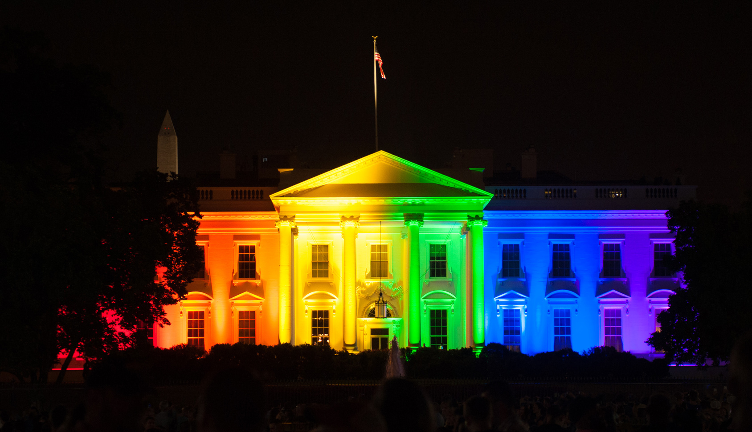
How Can Providers Support YMSM Clients?
108
Notes:
This next section will look at how providers can support YMSM clients.

Slide 109
Providers Supporting YMSM
Encourage Social Networks
Identify Community Support
YMSM
Racial/Ethnic Minority
Sexual
Minority
Gender
Minority
Create Safe Environment
Recognize Self-Efficacy & Resiliency
Notes:
Trainer revisits the prior schematic showing the multi-minority stressors for YMSMs.
Trainer now shows the added interventions on the periphery. (i.e, creating safe environment, identifying community support, encouraging social networks, recognizing self-efficacy and resiliency)
Trainer points to these interventions as strategies providers can use to add protective elements that may support YMSMs.

Slide 110
Specific Recommendations
Recognize minority stress as a factor that may impact health outcomes for sexual minorities
Understand that for YMSM of color there may be *triple jeopardy* (race/ethnicity + sexual + gender minority stress)
Assess for minority stress factors in order to validate and provide space for YMSM to address the minority stress explicitly
Notes:
Trainer makes the following key points when introducing this slide:
To increase the likelihood of being effective, providers need to be aware minority stress exists
Providers can’t resolve or lessen minority stress but we can be cued into it as a factor that impacts mental and physical health
Have self-awareness to avoid adding to the minority stress with hidden biases, assumptions, stereotypes, and/or disregard for its significance
Large Group Discussion - Trainer asks:
What are ways in which providers can invite YMSMs to discuss their stress that may be related to their sexual risk behaviors? (sexual minority stress)
What are ways in which providers can invite YMSMs to discuss their stress that may be related to their race or ethnicity? (racial/ethnicity minority stress)
How might the provider assess if the YMSMs is experiencing isolation or has internalized negative stereotypes or internalized transphobia? (gender minority stress)

Slide 111
Exercise: Engaging Your Client
Each table will be a group
Read the short description about your client (Handout: client profiles for Deepesh, Donald, DeVaughn & DeJesus)
Identify if minority stress may be a factor and if so, what type (i.e., race/ethnicity, sexual, gender)
Create questions and/or statements to use in engaging your client to acknowledge minority stress
Notes:
Dyad Exercise – 15 minutes
Trainer instructs the participants to find a partner preferably someone they do not know well. Inform them that being able to engage openly with someone they don’t know well is transferable skill for working with client whom they may not know well.
*Note- If time does not permit, then trainer asks participants to turn to the person closest for the 15 minute activity
Instructions for the exercise
Based on the short description of the client, develop key questions or statements to help you:
Build rapport to create an environment where the client can discuss his vulnerabilities and stress recognizing that he may not call it out as minority stress, just like he may not refer to himself as a MSM
Identify community support, encourage social networks or recognize self-efficacy & resiliency
Handouts: Each client Profile below needs to be developed as a handout:
Deepesh is an 26 year-old bi-racial man who shares that he has sex with men and does not identify as gay or bisexual. He tells you he shuns labels of any kind and works hard every day to have people see him as a human being first instead of always trying to “figure me out by the way I look.”
Donald is a 24 year-old white man who shares that he has sex with men, does not identify as gay or bisexual, and keeps his private life to himself. He tells you he hates his job because his co-workers constantly joke about sex and tell homophobic and misogynistic jokes.
DeVaughn is an 18 year-old African American youth who shares that he has sex with boys his age and older men and does not identify as gay or bisexual. He lives at home with is family in an urban neighborhood with significant amounts for violence in the community.
DeJesus is an 20 year-old Latino man who shares that he has sex with men and does not identify as gay or bisexual. He said it would cost him his family if he were gay. His family considers being gay a curse. After losing his cousin to AIDS and watching his family shun him in his dire time of need, he tells you he often thinks his family is right. He feels cursed.
Process points:
Assess not assume.
Practice self-awareness to avoid
inflicting further minority stress (e.g., stereotyping, committing micro-agressions)

Slide 112
Process Questions for Participants
What questions and/or statements did you create for acknowledging minority stress?
  What questions and/or statements could you create to identify community support?
  What questions and/or statements could you create to identify social networks?
  What questions and/or statements could you use to recognize self-efficacy & resiliency?
Notes:
Trainer uses the process questions to guide the large group discussion based on the 4 short client descriptions.
Trainer reinforces the key areas are the ways that providers can support YMSMs as demonstrated by the visual on slide 15.

Slide 113
Summary
Minority stress is experienced by racial/ethnic, sexual, and gender minorities that may relate to mental and physical health disparities
YMSM may experience minority stress despite not claiming a sexual minority status (i.e., identifying as gay or bisexual)
Providers can have a positive impact based on principles of self-awareness, cultural humility, and client resiliency
Notes:
Trainer reviews the key points and connection between minority stress, YMSM and provider support.
Trainer reminds participants that the positive impact providers can have begins with
self-awareness- being mindful of unconscious bias, assumptions, stereotypes and other possible obstacles to recognizing minority stress exists
For some racial/ethnic, sexual, and gender minorities
Cultural competency – referring to the previous module emphasizing cultural competency as the ability to respectfully & effectively interact with different cultural groups
Resiliency – recognizing client coping strategies and helping the client to see these strategies as strengths as a foundation for creating positive health outcomes and possibly reducing the impact of minority stress

Slide 114
Treatment Considerations
MODULE 5
114
Notes:
This next module will focus on treatment considerations.

Slide 115
Goal of Module
By the end of this module, participants will be able to:
Identify one treatment approach that may be effective when working with YMSM
Identify one method to avoid provider burn out
Notes:
Trainer reviews the goals of the module by informing participants that at the end of the module, they will be able to:
-Identify one treatment approach that may be effective when working with YMSM
-Identify one method to avoid provider burn out

Slide 116


To treat me, you have to know who I am…
National LGBT Cancer Network
Notes:
Video was made by The National LGBT Cancer Network.
http://www.cancer-network.org/
"To Treat Me, You Have to Know Who I Am“ video was made for the New York City Health and Hospitals who launched a mandatory employee training program that will improve access to healthcare for lesbian, gay, bisexual and transgender (LGBT) individuals and help to reduce health disparities related to sexual orientation and gender identification. The training will teach staff to provide respectful, patient-centered and culturally competent healthcare services to thousands of LGBT New Yorkers who are served by the public hospitals, community health centers and nursing homes every year.
Find out more at http://www.nyc.gov/hhc.

Slide 117

Screening & Assessment
Notes:
This next section will discuss screening and assessments.

Slide 118
LGBT & YMSM Adolescent Assessment & Treatment Checklist
Alcohol, tobacco, and other drug use
The adolescents’ social environment
Sexual identity development
Stage of coming out
Level of disclosure about sexuality
Gender identity
Family and social support network
Impact of multiple identities: gender, ethnic, cultural, sexual orientation
Knowledge and use of safer sex practices
Notes:
This checklist can be used by providers as a guide on what to cover during an assessment.
An example of developing LGBT-sensitive assessment strategies is not making assumptions about one’s sexual orientation or gender identity.
An example of asking questions in an affirming way: “do you have a significant other?” and if the client responds yes, “what is the gender-identity of your significant other?”
Providers should also assess family and social related issues, their family of origin, their chosen family, any social involvement and possible social isolation
Provider can also assess any current or past connection to ethnic or cultural groups for support.

Slide 119
Taking a Family History
Inquiries for All Clients:
What were the rules of the family system?
Was there a history of physical, emotional, spiritual, or sexual trauma?
Were all family members expected to behave in a certain way?
What were the family’s expectations in regard to careers, relationships, appearance, status, or environment?
Was sex ever discussed?
Additional Inquiries for YMSM Clients:
How does the client identify?
Who is the client’s family?
Is the client out to his family? How did they respond?
Was anyone else in the family acknowledged to be or suspected of being a lesbian, gay, bisexual, or transgender individual?
What type of services has client received/does client want?
Notes:
This slide discusses the importance of taking a family history – including additional questions for MSM clients.

Slide 120
SBIRT
SBIRT is an evidence-based practice used to identify, reduce, and prevent problematic use of alcohol and illicit drugs.
Routine and universal screening is recommended for all clients. Particularly important for LGBT/YMSM clients given high rates of alcohol and substance use disorders in these populations.
Should also screen all clients for mental health disorders. Could utilize generic screens (e.g., MHSF-III) or tools that screen for particular problems (e.g., anxiety, depression, trauma, suicide).
Notes:
Screening, Brief Intervention, and Referral to Treatment (SBIRT) is an evidence-based practice used to identify, reduce, and prevent problematic use, abuse, and dependence on alcohol and illicit drugs. The SBIRT model was incited by an Institute of Medicine recommendation that called for community-based screening for health risk behaviors, including substance use.
For more information go to: http://www.integration.samhsa.gov/clinical-practice/sbirt

Slide 121
SBIRT
Screening: Universal, brief screen that identifies unhealthy substance use (or mental health) through interview or self report
  Assessment: additional validated tool to determine severity and consequences of use
Brief Intervention: Brief conversation to raise awareness of risks and build motivation to change
Referral to Treatment: a proactive process that facilitates access to substance use treatment, when appropriate
Notes:
SBIRT CONSISTS OF THREE MAJOR COMPONENTS:
Screening — a healthcare professional assesses a patient for risky substance use behaviors using standardized screening tools. Screening can occur in any healthcare setting
Brief Intervention — a healthcare professional engages a patient showing risky substance use behaviors in a short conversation, providing feedback and advice
Referral to Treatment — a healthcare professional provides a referral to brief therapy or additional treatment to patients who screen in need of additional services

Slide 122
Special Considerations at Intake for
YMSM Populations
Be sure to mention that all patients are being screened and information obtained during the screening process is kept strictly confidential
Ask patients how they identify (e.g., gender, sexual orientation), including what pronouns they prefer, and respect their wishes
NIAAA guideline for non-risky drinking in men is <14 drinks per week, no more than 4 per day. For women, <7 per week, no more than 3 per day.
  Which guidelines would you communicate to a trans man?
  How does taking hormones affect alcohol metabolism?
Notes:
For more information visit the National LGBT Health Education Center, a Program through the Fenway Institute.
Webinar: SBIRT And The LGBT Community: Identifying & Addressing Unhealthy Substance Use in Primary Care
Webinar on Feb. 4, 2015

Slide 123
Screening/Assessment Resources
Webinar by the National LGBT Health Education Center (Fenway Institute)
Title of webinar: SBIRT And The LGBT Community: Identifying & Addressing Unhealthy Substance Use in Primary Care
http://www.lgbthealtheducation.org/
Notes:
This slide shows additional resources for providers.

Slide 124

Evidence-Based Practices
124
Notes:
This next section looks at Evidence- Based practices.

Slide 125
What are the most important EBPs?
  Behavioral Approaches
    Motivational Interviewing/Brief Intervention
    Contingency Management
    Cognitive-Behavioral Coping Skills Training
    Couples and Family Counseling
    12 Step Facilitation and 12 Step Program Participation
  Medications for Substance Use Disorders
    Methadone
    Buprenorphine
    Naltrexone (oral and extended release)
    Naloxone (for overdose prevention)
    Acamprosate
    Antabuse
Notes:
This slide list the evidence based practices available for treatment substance use disorders.

Slide 126
Motivational Interviewing
Motivational interviewing is a client-centered style of interaction aimed at helping people explore their ambivalence about their substance use and begin to make positive behavioral and psychological changes. Goal is to enhance motivation to change behavior and elicit self-motivational statements using a supportive, non-confrontational style. The 5 principles of M.I. are:
              Express empathy
              Develop discrepancy
              Avoid argument
              Roll with resistance
              Support self-efficacy
Notes:
Motivational interviewing, a treatment approach developed by William Miller, has been well established as an effective way to promote behavior change in individuals. MI focuses on helping clients to engage in change talk, and then make commitments to make behavioral changes based on goals that they have identified. The goal is to elicit change talk from clients with low levels of readiness for change, thereby increasing levels of motivation and moving them toward action to address their substance use issues.

Slide 127

Promising Practice
The Anchor Project (Arizona)
SAMHSA-funded, collaboration of three organizations
Targets unstably- housed LGBT young adults
42% of participants are People of Color
Motivational Interviewing framework guides the program
Notes:
This slide looks at the ANCHOR project in Arizona. A webinar on this program can be found on the website: ymsmlgbt.org/webinars
The ANCHOR Project stands for:
Accessible Network for Coordinated Housing, Opportunities, and Resilience

Slide 128
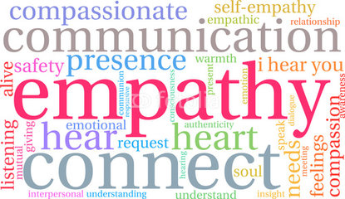
Service Population Needs
Societal Context
4 Core Needs for LGBTQ clients
  Safety
  Affirmation
  Community
  Autonomy
Notes:
Society is cis-centric (and binary) and hetero-centric – Bestows privilege on cisgender heterosexuality; Invisibly embedded in social norms, values, and taboos (Media and public policies are examples);
Becomes more visible is when it manifests as discrimination and violence
These needs can be compounded by intersecting identities, especially if other identities are also marginalized
In addition to addressing specific/material needs like access to physical and mental health services and stable housing, these disparities illuminate broader needs that we feel committed to addressing, and that are well-aligned with MI.

Slide 129
How Anchor Operationalizes MI
Formal & informal interactions
  4 skills – OARS
    Open-ended questions
    Affirmations
    Reflective listening
    Summary statements
S.H.A.R.E. - Negotiating Safer Sex
  Barriers to using barriers
    Cost-benefit analysis of using safer sex protection versus not
    Highlights conscious decision-making that occurs
  Sexual Health Practices Self-Efficacy Assessment
    Evaluate confidence level
    Identify ways to boost confidence
BUOY - Asking for Help
  Guiding vs. directive style
  Follow up questions
  Collaboration
Notes:
MI techniques – responses are generated by participants, not facilitator. If facilitator incorporates suggestions, they are phrased as questions.
4 Skills-OARS are evident in all staff/participant interactions.
BUOY Group: Building Understanding of Yourself is an LGBTQ-affirming support group offered every week that focuses on developing and practicing safe strategies for coping with difficult life experiences. BUOY encourages participants to apply new skills and information in their own lives. In this safe space, participants will have the opportunity to share their own experiences while gaining perspective and insight from the experiences of others. This is a great group to attend if you are looking to heal from trauma, grow as a person, and/or build community with others.
More info: https://anchorprojectarizona.org/about/supportive-services/weekly-lgbtq-affirming-support-group/
SHARE: S.H.A.R.E. (Sexual Health and Relationships Education) is an LGBTQ-affirming sexual health education group offered every other week at ANCHOR. Each session is free-standing, so no matter when you start coming or if you miss a day, you won’t feel lost the next time! Groups will involve a mix of information/lecture, brainstorming, discussion, individual and group activities. Participants will also have the opportunity to ask questions
anonymously.
More info: https://anchorprojectarizona.org/about/supportive-services/weekly-healthy-sexuality-relationships-group/

Slide 130
Principles of Cognitive Behavioral Therapy (CBT)
CBT is used to teach, encourage, and support individuals about how to reduce / stop their harmful drug use.
CBT provides skills that are valuable in assisting people to achieve initial abstinence from drugs (or to reduce their drug use).
CBT provides skills to help people sustain abstinence (relapse prevention).
Notes:
CBT focuses on how to manage life, sexual identity, anxiety and depression, substance abuse (Chesney et al. (2003).
CBT also help systematic desensitization. Some areas for systematic desensitization might include: social anxiety associated with coming out process, living with HIV, socializing in general in the LGBT community.
CBT also helps with relapse prevention, such as developing coping skills to reduce relapse into mental and/or substance use disorders.

Slide 131
Overview of CBT Approach
In the early stages of CBT treatment, strategies emphasize behavior change:
Setting a schedule to promote engagement in behaviors inconsistent with substance use
Recognizing and avoiding “high risk” situations
Facilitating positive coping skills
In later phases of recovery, more emphasis is given to the “cognitive” aspect:
Psychoeducation regarding addiction
Teaching clients about triggers and cravings
Teaching clients cognitive skills (e.g., “thought stopping” and “urge surfing”)
Identifying “red flag thoughts”
Notes:
Participants will learn how to take the CBT concepts and skills they developed and apply these skills with consumers with co-occurring mental health and substance use disorders. This training will provide participants with specific cognitive behavioral therapy (CBT) and relapse prevention (RP) strategies as they apply to substance use disorders with the goal of encouraging and enhancing the application of this evidence-based-practice in their daily clinical practice. Topics include the key principles of classical and operant conditioning as well as modeling; the five “W’s” of a client’s drug use; utilization of a functional analysis in early recovery and later in treatment to evaluate a relapse; assisting clients to recognize triggers and to be cognizant of how thoughts about drugs and alcohol impact cravings and ultimately lead to drug and/or alcohol use; drug-refusal skills; and structuring individual and group CBT sessions.

Slide 132
Promising Practices
Friends Getting Off provides group drug counseling for gay and bisexual men who use methamphetamine.
Combines group counseling with a behavioral intervention that gives rewards for providing negative urine samples.
Participation is eight weeks, followed by optional ongoing support groups, and one follow-up interview.
http://www.friendsgettingoff.org/
Notes:
Friends Getting Off is a clinic of Friends Community Center, a division of Friends Research Institute, Inc., in collaboration with UCLA Integrated Substance Abuse Programs and UCLA Department of Family Medicine. Funded by the County of Los Angeles, Department of Public Health and the City of West Hollywood.
The 8-week intervention involves group sessions in which cognitive behavioral therapy is delivered and individual meetings in which participants submit urine samples that are tested for recent use of methamphetamine.
Both cognitive behavioral group sessions and contingency management (voucher points for clean urines) have been evaluated and proven effective in helping gay and bisexual men achieve lasting reductions in methamphetamine use and high-risk sexual behavior by our research team (Drs. Reback and Shoptaw). This is the first time that two interventions, both previously found to be effective in reducing drug use and sexual risk behavior, have been combined into one package.
In the first 8 weeks:
Participants attend clinic three times per week (every Monday, Wednesday and Friday evening) for 90-minute group sessions. Group sessions teach skills to stop methamphetamine use and to prevent relapse using culturally relevant materials for gay and bisexual men. Participants receive “contingency management” for clean urine:
Before each group session, participants provide a urine sample. If the sample tests clean (no recent use of methamphetamine), voucher points that have cash value are provided that are then exchanged for gift cards, products or services.

Slide 133
Promising Practice
Tarzana Treatment Center’s Getting OFF! Program (Los Angeles, CA)
  Combination of three curriculums
    Getting Off w/ Friends (Modified Matrix Model)
    Better Self- Esteem
    Art Therapy
  Uses Evidence Based Practices
    Cognitive Behavioral Therapy
    Trauma Informed Practices
    Motivational Interviewing
    Strength Based Case Management
Notes:
Unconventional style in disseminating information
Humor
Analogies
Visuals & Discussions
Nurturing approach opposed to disciplinary action
Client Centered approach
Stresses engagement & relationship over curriculum
Non-Authoritative approach
Stresses collaboration over “Teacher/Student”
Use Cognitive Behavioral Therapy
Focus: Behavior change
ONE STEP FURTHER
Engagement & motivational interviewing skills to explore possible sources of the behavior
Approach allows us to identify past trauma
Use Art therapy to address experiences with trauma
Further explore in 1:1 Strength-Based Case Management sessions
Provides the opportunity to refer for additional supportive services
Use of Social Media for retention & engagement
Key to our success of obtaining the 6-month follow ups

Slide 134
Promising Practice
Exponents’ Project ASPIRE (New York, NY)
Care Coordination
Seeking Safety
Living Well
Referrals to HIV/HCV screening, drug treatment and/or ARRIVE
Targeted, Peer-Delivered Outreach
Q-YAB
Kiki Lounge
Social Events
Notes:
Exponents’
Affirming Self Through Pride, Information & Recovery Support
(Project ASPIRE)

Slide 135
12 Step Participation
There is an expanding body of research literature that documents the benefits of 12 Step program participation. Researchers at Stanford University (Moos, Finney, Humphreys and others) have amassed a substantial body of evidence that individuals who engage in the 12 Step program have better SUD outcomes and more improvement in the quality of life measures, than individuals who do not participate.
Identify YMSM/LGBT groups in your area
Notes:
Providers need to be knowledgeable of local groups that are LGBT-affirming and culturally specific. A resource list should be made readily available to all clients.
Encourage shopping around for the right self-help group.
Encourage engagement with a LGBT affirming sponsor.

Slide 136
Adapting EBP’s to YMSM
Evidence based treatment must be adapted to include culturally-relevant treatment strategies that address the specific needs of YMSM
(Jerome & Halkitis 2014)
Includes: outreach/recruitment strategies, therapist qualities, group characteristics, and intervention elements
Notes:
Article Title: Treatment strategies for Black, gay, bisexual, and heterosexual men-who-have-sex- with- men who use methamphetamine (Jerome & Halkitis, 2014)
Results indicated four treatment areas salient for BMSM seeking treatment for methamphetamine used disorders: (a) outreach/recruitment strategies, (b) therapist qualities, (c) group characteristics, and (d) intervention elements themselves. Findings gathered here and through literature review underscore the importance of adapting evidence-based methamphetamine treatment strategies to include culturally-relevant treatment strategies that address the specific needs of BMSM who use methamphetamine.
References:
Jerome, J. C., Halkitis, P. N. (2014). An Exploratory Investigation of Treatment Strategies for Black, Gay, Bisexual, and Heterosexual Men-Who-Have-Sex- With-Men Who Use Methamphetamine. Journal of LGBT Issues in Counseling. 8(1): 2 – 24

Slide 137

Promising Practices and Resources
137
Notes:
This next sections looks at some promising practices and resources for providers.

Slide 138

YMSM Provider Summit
Meeting was held September 10-11, 2015 at the Roosevelt Hotel in Hollywood, CA.
48 attendees from all over the country (providers applied to attend).
Notes:
In September 2015, the Substance Abuse and Mental Health Services Administration’s Center of Excellence on Racial and Ethnic Minority Men Who Have Sex with Men and Other Lesbian, Gay, Bisexual, and Transgender Populations (YMSM+LGBT CoE) convened a two-day National YMSM Provider Summit in Hollywood, California. The Summit brought together behavioral health and HIV service providers to identify strategies for engaging and retaining minority YMSM in HIV care.

Slide 139

YMSM Provider Summit
SUD, mental health, HIV providers and other experts discussed best practices and lessons learned to help decrease the rate of substance use and new HIV infections among racial/ethnic minority YMSM clients.
Notes:
On the first day of the Summit, YMSM+LGBT CoE staff led a group discussion of barriers and facilitators related to serving minority YMSM. Next, participants broke into four subgroups, and each subgroup discussed four domains related to services for minority YMSM: (1) Access to Services, (2) Outreach, Engagement, and Retention, (3) Continuing Care and Recovery Support, and (4) Health Literacy. Within each group, YMSM+LGBT CoE staff facilitated dialogue, and took detailed notes on discussions. At the end of the day YMSM+LGBT CoE staff collaboratively summarized and documented findings from the small group discussions.

Slide 140
YMSM Provider Summit Recommendations
Peer Services are Essential: Involving racial/ethnic minority YMSM with personal experience receiving YMSM services in all aspects of service delivery is critical. Peers can serve as positive role models for minority YMSM, help fight stigma by representing services in the community, and make invaluable contributions to treatment by bringing client perspectives to programming and services.
Notes:
Recommendations from the Summit include:
Peer Services
KC Care Clinic (Kansas City, MO): At the KC Care Clinic, peer educators operate as integral members of health care teams that provide services for clients living with HIV. Peer educators provide clients with information about: HIV; how to communicate with doctors and service providers; how to understand lab test results; issues surrounding medication resistance and adherence; medications; managing side effects; safe sex; exercise; and nutrition. In addition, peers provide clients with links to community resources, hope, personal support, self-management strategies, and options to support medication adherence. Having personally experienced HIV treatment, they have a strong understanding of barriers to HIV treatment and medication adherence, as well as strategies that can be helpful in overcoming these barriers. Peer services are targeted to reach clients who are preparing to start HIV medications, individuals changing HIV medication regimens, pregnant women who are diagnosed with HIV, clients who struggle keeping medical appointments, and persons who would like to improve their relationships with their health care team.

Slide 141
YMSM Provider Summit Recommendations
Services Need to be Holistic: Though racial/ethnic minority YMSM may have pressing service needs related to behavioral health and HIV, they often face a variety of social and legal challenges. By making care holistic, and designing it to help YMSM address all of their life challenges, providers can better engage minority YMSM in treatment and ensure that all of their needs—not just those related to behavioral health and HIV—are properly addressed.
Notes:
Recommendations Continued:
Holistic Care
Hetrick-Martin Institute (New York, NY): The Hetrick-Martin Institute provides HIV services for YMSM and other LGBTQ populations within a comprehensive set of services where youth can obtain support with housing, mental health, academic enrichment, job readiness, and other services that support clients’ development and success. Services are designed to provide a system of support to help clients achieve milestones appropriate to their development by creating a supportive environment and improving systems of support available to YMSM.

Slide 142
YMSM Provider Summit Recommendations
Services Need to be Fun: In order to engage racial/ethnic minority YMSM in treatment and keep them engaged in continuing care and recovery, it is important to make services engaging and fun. Continuously devising creative strategies to make services novel and engaging is critical.
Notes:
Recommendations Continued:
Services need to be fun.
Trillium Health (Rochester, NY): Trillium Health has devised several creative programs to engage YMSM in their community. It has established “Vogue Nights,” where part of the clinic space is opened to be used as practice space for young men interested in practicing their dance moves. These nights serve a dual purpose, as they give local YMSM an opportunity to meet other YMSM in a safe, community-oriented space, while also giving them a chance to see the clinic and learn about the services it offers. In addition, Trillium is beginning to develop open-mic nights at a local gay-friendly coffee shop, and panel discussion that bring in community members to discuss health-related and other issues of interest to local racial/ethnic minority YMSM.

Slide 143
YMSM Provider Summit Recommendations
Technology is Important: YMSM today grew up in the internet age, and services need to incorporate technology—particularly social media—since it is central to how they find health information and make decisions.
Notes:
Recommendations Continued:
Technology is important.
Warren-Vance Community Health Center (Henderson, NC): The Warren-Vance Community Health Center integrates multiple social media tools into the services it provides for clients living with HIV in order to maintain a healthy relationship with clients; aid in care, retention, and compliance; keep the clinic up to date with the communication tools used by youth; and have backup contact information when traditional methods fail. Case managers use social media as retention tools, utilizing Facebook and Facebook Messenger to communicate with clients who do not have a working phone, contact clients regarding logistical issues (e.g. transportation, clinic closures, appointment reminders), and search for clients who have fallen out of care. The clinic also uses Glide, a smart phone app that allows for video and text messaging, to help maintain relationships with clients, review client needs in real-time, send text messages regarding medical appointments, and keep clients engaged in care by staying in contact. They also utilize Voxer, a smart phone app that allows phones to operate as walkie-talkies, to send and receive quick voice messages, and give clients a way to get in contact with providers quickly. Another interactive App, Care4Today, is used to help clients track their medication adherence, and also allows case managers to monitor and encourage clients to stay on schedule with their medications. Warren-Vance also has a Facebook page for clients to ask questions, learn, and share their experiences with HIV and HIV treatment with their peers.

Slide 144
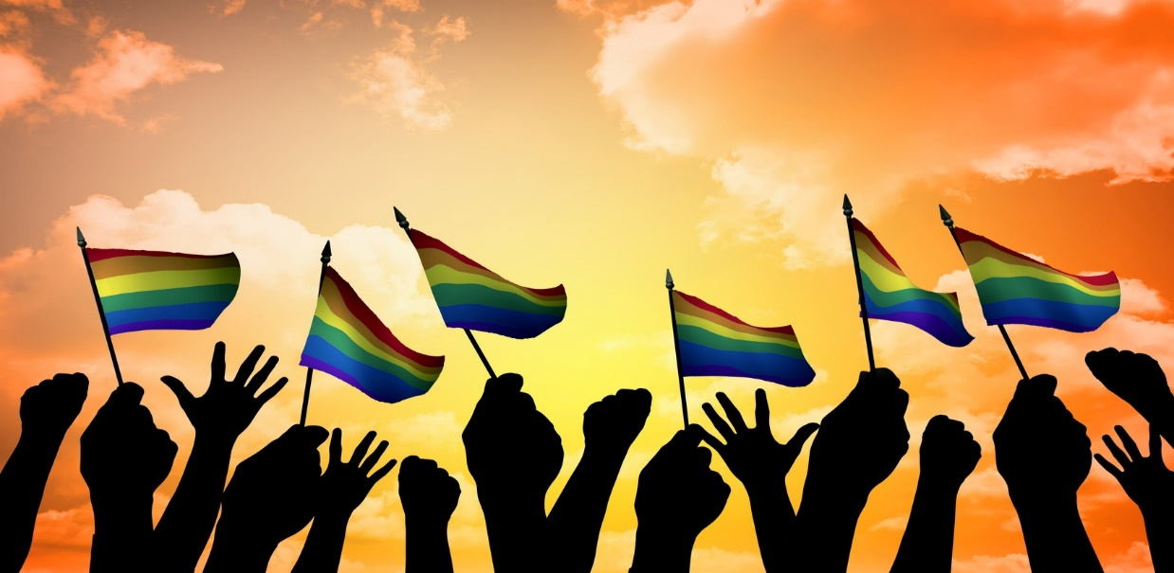
Best Practices
Be the champion in your organization
Agency Collaborations: form partnerships with LGBT agencies in your community (HIV, Community Agencies, social services)
Use of Peer Navigators
Use of Social Networks
Role of Social Media
Notes:
The next few slides go over Best Practices to help engage and retain YMSM in care.

Slide 145

Best Practices
Processes and forms reflect diversity of LGBT & YMSM people and relationships
  Use words like “relationships, partners, parents”. Ask for preferred name/pronoun. “He”, “His” preferred pronoun/name usage is culturally proficient practice.
Data is collected on sexual orientation and gender identity (include in EHRs)
  We need data to accurately track health disparities.
All patients receive sexual health histories
Look at the whole person – integrated care
  Unmet medical, mental/SUD health needs, socioeconomic, legal

Slide 146
Best Practices
Don’t make assumptions about gender identity or sexual orientation.
If you make a mistake or don’t know something. Don’t be afraid to apologize.
Respect confidentiality.
Don’t police public restrooms.
Don’t expect a trans man to be the resident trans expert. As with any group, there is a lot of diversity within the trans community.
Do not sensationalize or sexualize trans bodies. It is generally inappropriate to ask a trans man whether he has had surgery (this is like asking him what his genitals look like)or how he has sex.
Notes:
Trainer Notes:

Slide 147
Best Practices
Providers can have a positive impact based on principles of self-awareness, cultural competency, client resiliency
Cultural humility requires consistent re-self-appraisal; check in with yourself…forever and ever!
Notes:
Trainer reviews the key points and connection between minority stress, YMSM and provider support.
Trainer reminds participants that the positive impact providers can have begins with
self-awareness- being mindful of unconscious bias, assumptions, stereotypes and other possible obstacles to recognizing minority stress exists
For some racial/ethnic, sexual, and gender minorities
Cultural competency – referring to the previous module emphasizing cultural competency as the ability to respectfully & effectively interact with different cultural groups
Resiliency – recognizing client coping strategies and helping the client to see these strategies as strengths as a foundation for creating positive health outcomes and possibly reducing the impact of minority stress

Slide 148
Creating a Welcoming Culture
Post a sign that says "We do not discriminate on the basis of age, race, sex, sexual orientation, gender identity/expression, religion, language, or disability.“
Have an affirmative action policy for hiring "out" transgender people. This will go a long way towards making trans clients more comfortable in your program.
Waiting room reading materials and bulletin boards should include positive items about the diversity of the clients you serve.
Explicitly discuss and maintain confidentiality.
Learn how to ask sensitive, open and direct questions about gender issues, sexual orientation, risk behaviors and overall life adjustment.
Provide gender neutral bathrooms wherever possible.

Slide 149

How Can Providers Avoid Burnout?
149
Notes:
Burnout is common among workers in helping professions. A conservative estimate is that between 65 and 75% of those working in helping professions will experience burnout in the first three to five years of employment, though it can occur at any point in one’s career.
REFERENCE:
Masters, R.E. (2004). Counseling Criminal Justice Offenders, 2nd Edition. Thousand Oaks, CA, Sage Publications.

Slide 150
What is Burnout?
Burnout was identified 40 years ago to describe a state of fatigue and frustration among health care and service providers arising from excessive demands on their resources.
Burnout Syndrome is the reaction of the body and mind to persistent stress.
Components include:
Exhaustion (emotional and physical)
Cynicism (detachment from clients and work)
Ineffectiveness (feeling inadequate and dissatisfied with work)
SOURCE: Maslach & Leiter, 2003.
Notes:
‘Burnout Syndrome’ was first identified by Herbert Freudenberger, a psychoanalyst, in 1974 to describe a point at which a care worker’s emotional resources were exhausted. The concept was later refined by Maslach and Jackson to describe a particular kind of stress that occurs in occupations where: the environment is demanding, the jobs are interpersonal, and in which chronic emotional exhaustion, depersonalization and lack of personal accomplishment are found. Maslach and Jackson then constructed The Maslach Burnout Inventory in 1996, an evaluation instrument still commonly used today.
REFERENCE:
Maslach, C. & Leiter, M.P. (2003). The truth about burnout: how organizations cause personal stress and what to do about it. San Francisco: Jossey-Bass.
ADDITIONAL RESOURCES:
Health Resources Services Administration. (2007). Burnout. HRSA CareACTION. (March) 1-8.
Jiménez, B.M., Carvajal, R.R., Furlong, L.V., Hernández, E.V., & Benadero, E.M. (2006). Burnout process and HIV/AIDS: main implications for health care workers. Revista Colombiana de Psicología, (15), 67-80.
Maslach, C. & Jackson, S.E. (1986). Maslach Burnout Inventory Manual. 2nd ed. Palo Alto, CA: Consulting Psychologists Press.

Slide 151
Symptoms of Burnout
SOURCE: Figley, 1999.
Physical
  Difficulty Sleeping
  Fatigue/exhaustion
  GI problems/Headaches
  Increase in colds/flus
Emotional
  Anxiety
  Depression/Guilt
  Irritability
  Helplessness
Behavioral
  Aggression
  Callousness/cynicism
  Defensiveness/Pessimism
  Substance Abuse
Interpersonal
  Dehumanization of patients
  Reduced communication w/co-workers/ patients
  Withdrawal from colleagues or patients
Work-related
  Decrease/poor performance
  Absenteeism, tardiness
  Attrition
  Misuse of work breaks
  Thefts
Notes:
Next, presenter compares the list generated by participants with the outline on this and the next slide. It is clear that burnout can effect each individual caregiver in uniquely personal ways.
REFERENCE:
Figley, CR. (1999). Compassion fatigue: toward a new understanding of the costs of caring. In: Stamm, BH (ed). Secondary traumatic stress (2nd ed.). Baltimore, MD: Sidrian Press.

Slide 152
Who is Most At Risk?
People in care professions
Workers who are very dedicated and idealistic
Caregivers that are depressed or anxious
Providers who believe events occur outside of their control
Caregivers who cope with stress externally
Younger, less experienced workers
Male caregivers
SOURCE: Demmer, 2004.
Notes:
Anyone who works in helping professions is vulnerable to burnout, but the list above details those MOST at risk. A theme arises – those who care deeply, but feel that things happen outside of their control are especially vulnerable. Older, more experienced workers are more likely to use internal coping strategies (expressing feelings, patience and optimism) and control their work-related stress more effectively than younger, less experienced workers. Males are more at risk because they are are less likely to seek support and services to mitigate symptoms.
REFERENCE:
Demmer, C. (2004). Burnout: the health care worker as survivor. AIDS Reader, (14): 522-523, 528-530. 535-537.

Slide 153
External vs. Internal Coping
Internal Coping
  Expression of feelings
  Patience
  Persistence
  Optimism
  Lower burnout risk
External Coping
  Denial
  Avoidance
  Passive Acceptance
  Reliance on faith/prayer
  Fatalism/helplessness
  Higher burnout risk
SOURCE: Demmer, 2004.; Jiménez, et al., 2006.
Notes:
This slide further details the difference between external and internal coping mechanisms … internal coping poses a lower burnout risk. Care providers who rely on external coping strategies generally do not believe that they have control over work-related stressors. They can exhibit negative expectations and a passive or fatalistic attitude that can lead to feelings of helplessness.
REFERENCES:
Demmer, C. (2004). Burnout: the health care worker as survivor. AIDS Reader, (14): 522-523, 528-530. 535-537.
Jiménez, B.M., Carvajal, R.R., Fulrong, L.V., Hernández, E.V., & Benadero, E.M. (2006). Burnout process and HIV/AIDS: main implications for health care workers. Revista Colombiana de Psicología, (15), 67-80.

Slide 154
Burnout Prevention/Treatment
Recognize and Accept – your work is stressful (as is your own humanity)
Take Time Out – step away when you can/vacations and time off
Connect – take time with friends outside of work and trusted colleagues
Exercise – endorphins help relieve stress
Vent – cry, scream, express feelings
Sleep – 8 hours
Notes:
Many caregivers are not good at caring for themselves. The importance of taking time off and stepping away cannot be over-emphasized. Social interaction is a key coping mechanism as colleagues and loved ones can offer catharsis and support. Exercise is another important burnout prevention strategy; physical exhaustion from exercise provides significant stress relief. Cardiovascular exercise relieves tension and frustration, while endorphins can also help relieve symptoms of depression. Physical release of stress through venting emotions and feelings can also be a powerful way to cope with them. Finally, insufficient sleep leads to low levels of productivity, greater health care needs and being accident prone.
REFERENCE:
Health Resources Services Administration. (2007). Burnout. HRSA CareACTION. (March) 1-8.

Slide 155
How Can Organizations Help?
Recognize and accept that the work is stressful
Learn to identify signs of burnout in employees
Offer assistance and solutions to those who are struggling:
  Consider increasing responsibility (allows workers more accountability and a greater sense of purpose)
  Supportive services – workshops, support groups and retreats
SOURCE: HRSA, 2007.
Notes:
Along with contributing to employee burnout, organizations can also suffer from the effects of burnout. Employees may fall prey to physical/emotional problems and poor job performance. Burnout can cause good employees to leave their jobs prematurely (usually after approximately 2 years). It is then in the best interest of care organizations to take steps to mitigate stress and burnout in its employees. Stress-reduction services, including workshops, support groups and retreats can be effective in mitigating stress. Providing options for more private supportive services (online support, etc.) can be an important option for those workers who may not feel safe in receiving public support among co-workers. Increasing a worker’s responsibility can lead to a greater sense of personal control, allowing workers a greater sense of purpose on in their work.
REFERENCE:
Health Resources Services Administration. (2007). Burnout. HRSA CareACTION. (March) 1-8.

Slide 156

Resources
156
Notes:
These next slides contain resources for attendees.

Slide 157
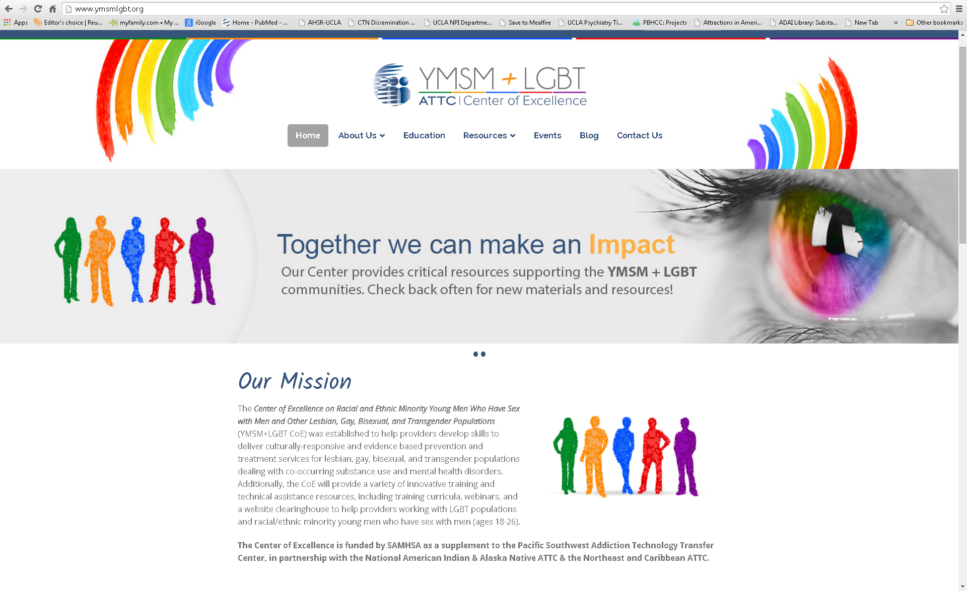
www.ymsmlgbt.org
Notes:
The YMSM+ LGBT COE website contains links to all of the resources contained in this training and more.

Slide 158

Clearing House Resource www.ymsmlgbt.org
Clearinghouse: resources, tool-kits
LGBT Curriculum
YMSM Curriculum
Library of relevant articles
Links to other organizations
Notes:
This lists the resources available on the website.

Slide 159

Save the Date!
We host quarterly Webinars!
  Sign-up for our Blog/Newsletter
  to hear about upcoming events:
  www.ymsmlgbt.org
Notes:
We hold monthly webinars on topics related to YMSM+LGBT issues.

Slide 160
Questions and Comments
Thomas Freese
tfreese@mednet.ucla.edu
Beth Rutkowski
brutkowski@mednet.ucla.edu

Slide 161
Hepatitis C (HCV)
ATTC Network’s HCV Initiative: http://www.attcnetwork.org/projects/HCV_Home.aspx)
AASLD & IDSA: www.hcvguidelines.org
CDC, Center for Disease Control and Prevention, Viral Hepatitis: http://www.cdc.gov/hepatitis
US Department of Veteran Affairs, Viral Hepatitis: www.hepatitis.va.gov
Stakeholders’ Workbook: Exploring Vital Roles and Opportunities to Break the Silence: http://aids.gov/pdf/vhap-workbook-for-stakeholders.pdf
Caring Ambassadors: http://caringambassadors.org/
National Viral Hepatitis Roundtable: http://nvhr.org/
Help-4-Hep: http://help4hep.org/
HCV Advocate: Hepatitis C – Living with Hepatitis C, http://www.hcvadvocate.org
American Liver Foundation Support Services: http://www.liverfoundation.org/support

Slide 162
HIV Links
HIV Information/Education; http://www.cdc.gov/hiv/basics/index.html
Condom Negotiation Skills;
http://www.cdc.gov/hiv/prevention/research/compendium/rr/sssb.html
HIV Testing; http://www.cdc.gov/hiv/testing/index.html
PrEP; http://www.cdc.gov/hiv/basics/prep.html
PEP; http://www.cdc.gov/hiv/basics/pep.html

Slide 163
Substance Use Links
SAMHSA; http://www.samhsa.gov/
NIDA; https://www.drugabuse.gov/
ATTC Network; http://www.attcnetwork.org/home/
NIAAA; http://www.niaaa.nih.gov/
Center for Integrated Health Solutions; http://www.thenationalcouncil.org/consulting-best-practices/center-for-integrated-health-solution/
Motivational Interviewing; http://motivationalinterviewing.org/
SBIRT; http://www.samhsa.gov/sbirt
Medication Assisted Treatment; http://www.samhsa.gov/medication-assisted-treatment

Slide 164
Suicide Prevention Links
Stop Bullying: http://www.stopbullying.gov/at-risk/groups/lgbt/index.html
Trevor Project (youth hotline): http://www.thetrevorproject.org/
CDC LGBT Youth: http://www.cdc.gov/lgbthealth/youth-resources.htm
Family Acceptance Project: http://familyproject.sfsu.edu/

Slide 165
Trauma Informed Care
SAMHSA Trauma Informed Care:
http://www.samhsa.gov/nctic
http://www.samhsa.gov/trauma-violence

Slide 166
Curriculum Authors
Michael Chaple, PhD
Thomas Freese, PhD
Kim-Monique Johnson
Phil Meyer, LCSW
Beth Rutkowski, MPH
Paul Warren, LMSW

Slide 167
References
Buller, A.M., Devries, K.M., Howard, L.M., & Bacchus, L.J. (2014). Associations between intimate partner violence and health among men who have sex with men: A systematic review and meta-analysis. PLoS Med, 11(3), e1001609.
Centers for Disease Control & Prevention. (2014). HIV surveillance in adolescents and young adults, www.cdc.gov/hiv/topics/surveillance/resources/slides/adolescents/index.htm (Accessed June 10, 2014).
Centers for Disease Control & Prevention. (2013). Diagnoses of HIV infection in the United States and Dependent areas, 2011. HIV Surveillance Report, 23.
Clatts, M.C., Goldsamt, L., Yi, H., & Viorst Gwadz, M. (2005). Homelessness and drug use among young men who have sex with men in New York City: A preliminary epidemiological trajectory. Journal of Adolescence, 28, 201-214.
Demmer, C. (2004). Burnout: the health care worker as survivor. AIDS Reader, (14): 522-523, 528-530. 535-537.
Feldman, M.B. (2010). A critical literature review to identify possible causes of higher rates of HIV infection among young black and Latino men who have sex with men. J Natl Med Assoc, 102, 1206-1221.
Fiellin, 2008
Friedman, M.S., Marshal, M.P., Stall, R., Cheong, J.-W., & Wright, E.R. (2008). Gay-related development, early abuse, and adult health outcomes among gay males. AIDS Behavior, 12(6), 891-902.
Health Resources Services Administration. (2007). Burnout. HRSA CareACTION. (March) 1-8.
Holloway, I.W., Shrager, S.M., Wong, C.F., Dunlap, S.L., & Kipke, M.D. (2014). Venue-based network analysis to inform HIV prevention efforts among young gay, bisexual, and other men who have sex with men. Prevention Science, 15, 419-427.

Slide 168
References
Jerome, J. C., Halkitis, P. N. (2014). An Exploratory Investigation of Treatment Strategies for Black, Gay, Bisexual, and Heterosexual Men-Who-Have-Sex- With-Men Who Use
Johns Hopkins. (2015). In Johns Hopkins University LGBT Glossary online. Retrieved from http://web.jhu.edu/LGBTQ/glossary.html
Jiménez, B.M., Carvajal, R.R., Furlong, L.V., Hernández, E.V., & Benadero, E.M. (2006). Burnout process and HIV/AIDS: main implications for health care workers. Revista Colombiana de Psicología, (15), 67-80.
Keatley, J.G., Deutsch, M.B., Sevelius, J.M., Gutierrez-Mock, L. (2015). Creating a foundation for improving trans health: Understanding trans identities and health care needs. In Makadon, H.J., Mayer, K.H., Potter, J., Goldhammer H. (Eds), The Fenway Guide to Lesbian, Gay, Bisexual, and Transgender Health 2nd Edition (pp. 459-478). Philadelphia, PA: American College of Physicians
Kirwan Institute, Implicit Bias http://kirwaninstitute.osu.edu/wp-content/uploads/2014/03/2014-implicit-bias.pdf
Koblin, B.A., Husnik, M.J., Colfax, G., Huang, Y., Madison, M., Mayer, K., Barresi, P.J., Coates, T.J., Chesney, M.A., & Buchbinder, S. (2006). Risk factors for HIV infection among men who have sex with men. AIDS, 20, 731-739.
Lampinen, T.M., Chan, K., Anema, A., Miller, M.L., Schilder A.J., Schecter, M.T., Hogg, R.S., & Strathdee, S.A. (2008). Incidence of and risk factors for sexual orientation-related physical assault among young men who have sex with men. American Journal of Public Health, 98, 1028-1035.

Slide 169
References
Masters, R.E. (2004). Counseling Criminal Justice Offenders, 2nd Edition. Thousand Oaks, CA, Sage Publications.
Marshall, B.D.L., Kahler, C.W., Koblin, B.A., Mayer, K.H., Mimiaga, M.J., van den Berg, J.J., Zaller, N.D., & Operario, D. (2015). Heavy drinking trajectories among men who have sex with men: A longitudinal, group-based analysis. Alcoholism: Clinical and Experimental Research, 39(2), 380-389.
McLaughlin, K.A., Hatzenbuehler, M.L., & Keyes, K.M. American Journal of Public Health. 2010
Millett GA, Peterson JL, Wolitski R, et al. Greater risk for HIV infection of Black men who have sex with men: A critical literature review. Am J Public Health. 2006;96:1007-1019
Mustanski, B.S., Newcomb, M.E., Du Bois, S.N., Garcia, S.G., & Grov, C. (2011). HIV in young men who have sex with men: A review of epidemiology, risk, and protector factors, and interventions. Journal of Sexual Research, 48(2-3), 218-253.
Mustanski, B. (2007). The influence of state and trait affect on HIV risk behaviors: A daily diary study of MSM. Health Psychology, 26(5), 618-626.
Mustanski, B.S., Newcomb, M.E., Du Bois, S.N., Garcia, S.G., & Grov, C. (2011). HIV in young men who have sex with men: A review of epidemiology, risk, and protector factors, and interventions. Journal of Sexual Research, 48(2-3), 218-253.
Newcomb, M.E., Ryan, D.T., Greene, G.J., Garofalo, R., & Mustanski, B. (2014). Prevalence and patterns of smoking, alcohol use, and illicit drug use in young men who have sex with men. Drug and Alcohol Dependence, 141, 65-71.

Slide 170
References
Operario, D., Choi, K-H., Lee Chu, P., McFarland, W., Secura, G.M., Behel, S., MacKellar, D., & Valleroy, L. (2006). Prevalence and correlates of substance use among young Asian Pacific Islander men who have sex with men. Prevention Science, 7(1), 19-29.
Prejean, J., Song, R., Hernandez, A., et al. (2011). Estimated HIV incidence in the United States, 2006-2009. PLoS One, 6, e17502.
Remafedi, G. (2002). Suicidality in a venue-based sample of young men who have sex with men. Journal of Adolescent Health, 31, 305-310.
Safren, S.A., Reisner, S.L., Herrick, A., Mimiaga, M.J., & Stall, R. (2010). Mental health and HIV risk in men who have sex with men. J Acquir Immune Defic Syndr, 55(Suppl 2), S74-S77.
Shore, R. (1997). Rethinking the Brain. New York: Families and Work Institute.
Suicide Prevention Resource Center. (2008). Suicide Risk and Prevention for Lesbian, Gay, Bisexual, and Transgender Youth. Newton, MA: Education Development Center, Inc.
Tervalon, M. & Murray-Garcia, J. (1998), Journal of Health Care for the Poor and Underserved, 9(2), 117
Traube, D.E., Schrager, S.M., Holloway, I.W., Weiss, G., & Kipke, M.D. (2013). Environmental risk, social cognition, and drug use among young men who have sex with men; Longitudinal effects of minority status on health processes and outcomes. Drug Alcohol Depend, 127, 1-7.
Tucker, J.S, Hu, J., Golinelli, D., Kennedy, D.P., Green, H.D., et al. (2012). Social network and individual correlates of sexual risk behavior among homeless MSM youth. J Adolescent Health, 51, 386-392.
US Department of Health & Human Services, Office of Minority Health, http://minorityhealth.hhs.gov/templates/browse.aspx?lvl=2&lvlid=11
Xu, F., Sternberg, M.R., & Markowitz, L.E. (2010). Men who have sex with men in the United States: demographic and behavioral characteristics and prevalance of HIV and HSV-2 infection: results from national health and nutrition examination survey 2001-2006. Sexually Transmitted Diseases, 37(6): 399-405.

Slide 171

Glossary of Key terms
171
Notes:
This next few slides contains a glossary of key terms.

Slide 172
Lesbian: a female who is emotionally, romantically, sexually, affectionately or relationally attracted to other females
Gay Male: a male who is emotionally, romantically, sexually, affectionately or relationally attracted to other males
Bisexual: an individual who is emotionally, romantically, sexually, affectionately or relationally attracted to both men and women (or to people of any gender identity)
Transgender: refers to a person whose gender identity does not correspond to their sex assigned at birth. May be used to refer to an individual person’s gender identity and is sometimes used as an umbrella term for all people who do not conform to traditional gender norms
(Johns Hopkins, 2015; Keatley et al., 2015)

Slide 173
Trans Man: A person who was assigned a female sex at birth and who now identifies as male. Some clients may use the term FTM (female to male).
Trans Female: A person who was assigned a male sex at birth and who now identifies as female. Some clients may use the term MTF (male to female).
Cisgender: Birth-assigned sex, “body parts,” and gender identity (your internal sense of who you are in terms of gender) are congruent.
Notes:
Trainer Notes:

Slide 174
MSM: an abbreviation for “Men who have Sex with Men”. This term focuses on behaviors. The term does not indicate sexual orientation.
WSW: an abbreviation for “Women who have Sex with Women”. This term focuses on behaviors. The term does not indicate sexual orientation.
(Johns Hopkins, 2015; Keatley et al., 2015)

Slide 175
Heterosexism: the assumption all people are or should be heterosexual. Assumption that heterosexuality is inherently normal and superior to LGBTQ people’s lives and relationships.
Ally: those who support and respect sexual diversity and challenges homophobic, biphobic, transphobic and heterosexist remarks and behaviors. Those who are willing to explore and understand these forms of bias within themselves.
(Johns Hopkins, 2015; Keatley et al., 2015)

Slide 176
Sexual Orientation: a consistent pattern of sexual desire for individuals of the same sex, other sex, or both sexes, regardless of whether this pattern is manifested in sexual behavior. Indicators of sexual orientation can include sexual and romantic desire, attraction, arousal and fantasy.
Sexual Identity: a culturally organized concept of the self. Labels can include lesbian, gay, bisexual, or heterosexual.
(Diamond, 2008; Savin-Williams & Vrangalove, 2013)

Slide 177

Center of Excellence on YMSM+LGBT
Thomas E. Freese, PhD
PSATTC/UCLA ISAP
tfreese@mednet.ucla.edu
Michael Chaple, PhD
NeC-ATTC/NDRI
chaple@ndri.org
Anne Helene Skinstad, PhD
NAI & AN ATTC/UIowa
anne-skinstad@uiowa.edu

